Slide 1
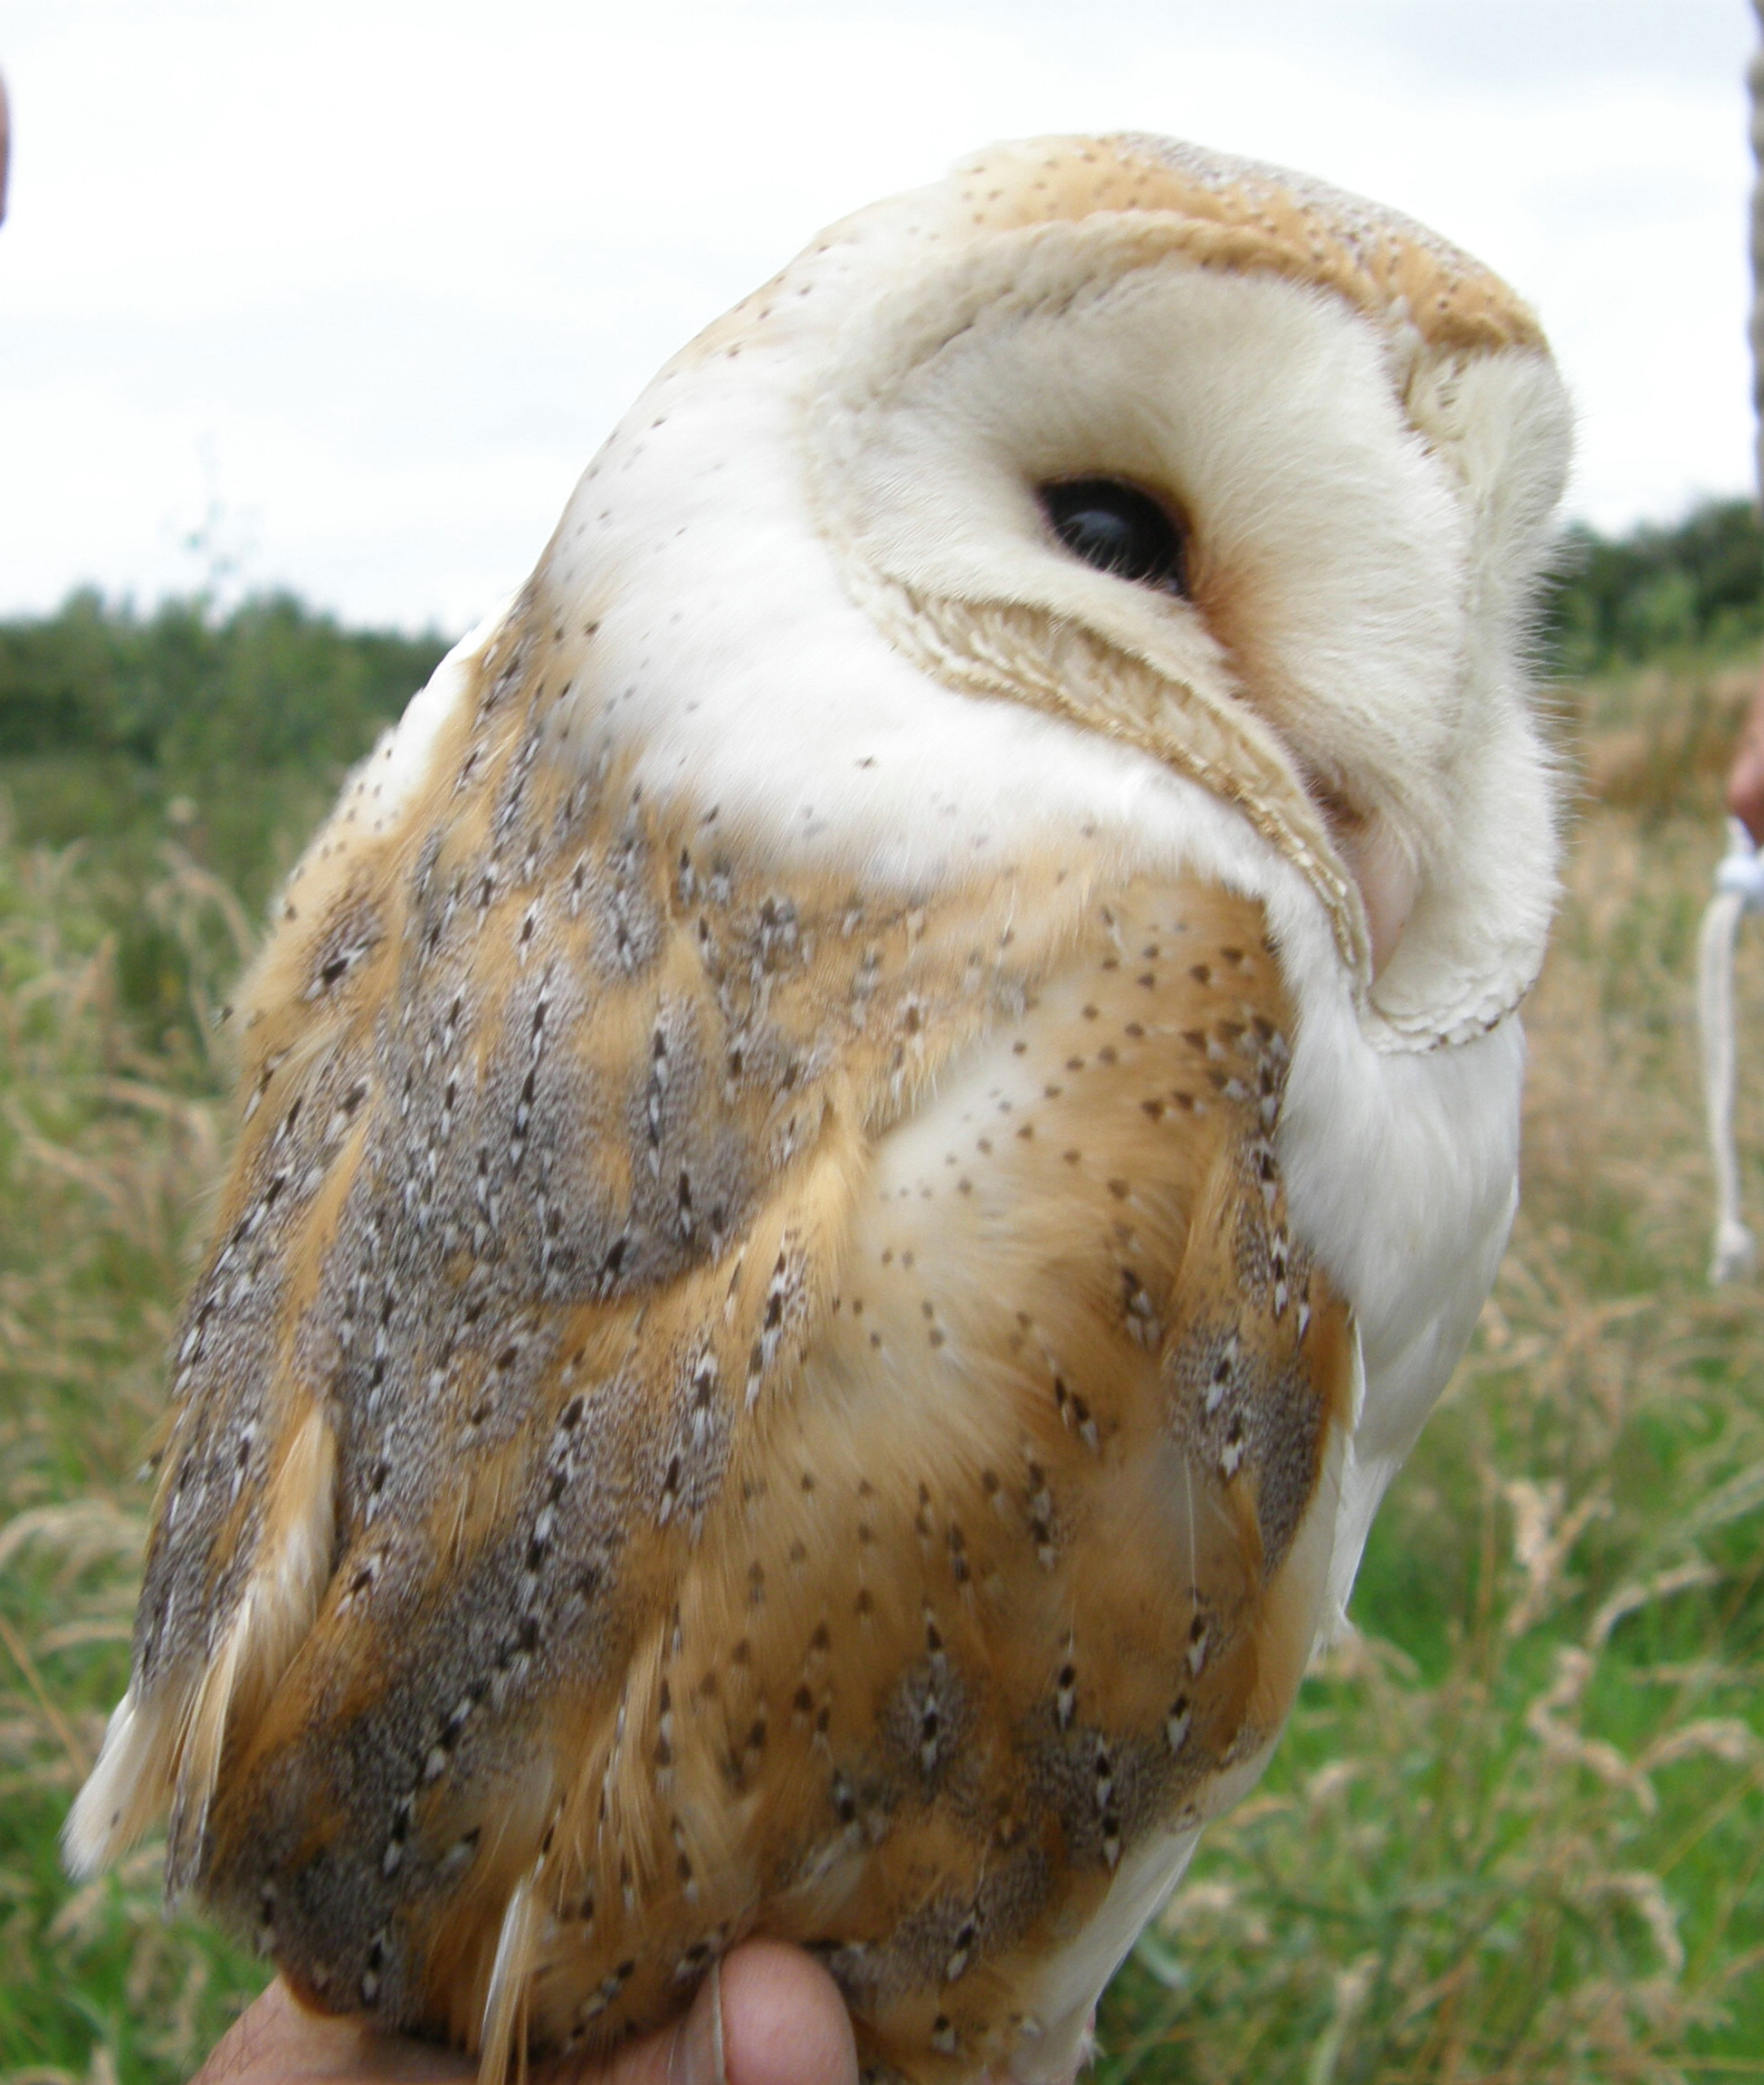
The Barn Owl
WELCOME
Steven Prince / Chris Whitehurst
Broxton Barn Owl Group (BBOG)
Notes:
1

Slide 2
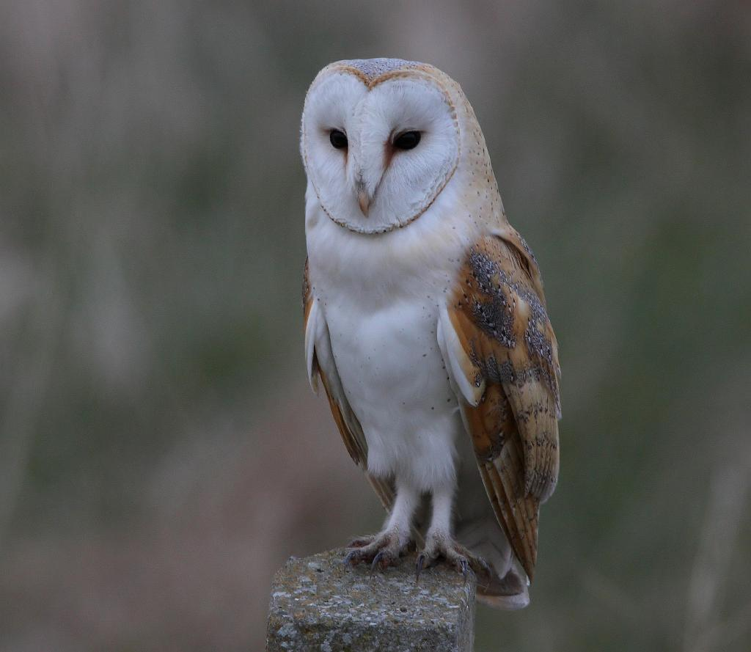
The Barn Owl
(Tyto alba)
What do they sound like?

Slide 3
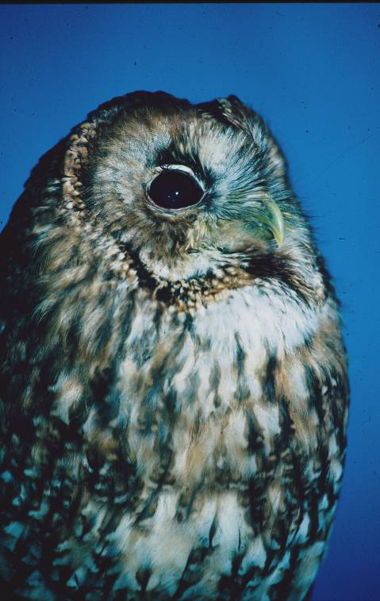

Slide 4
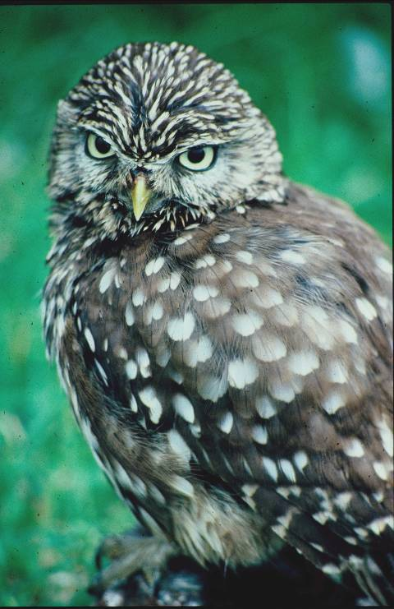

Slide 5
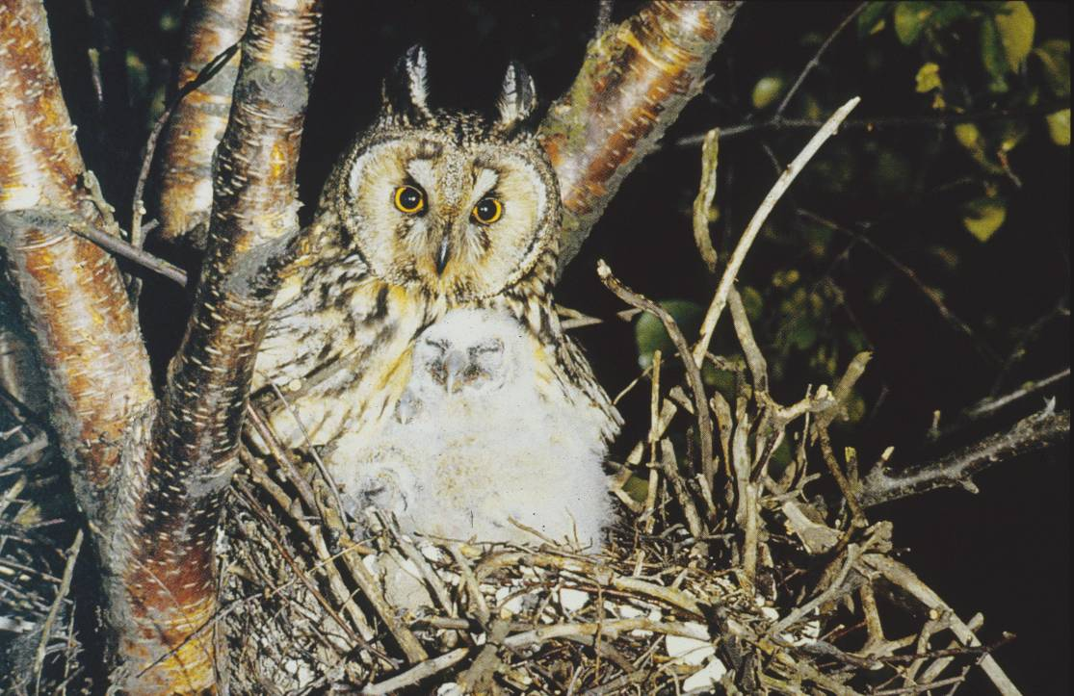

Slide 6
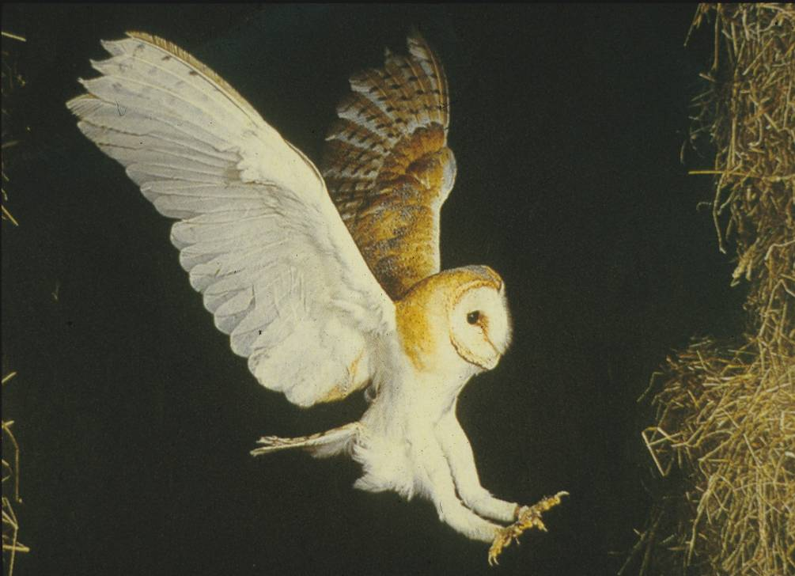

Slide 7
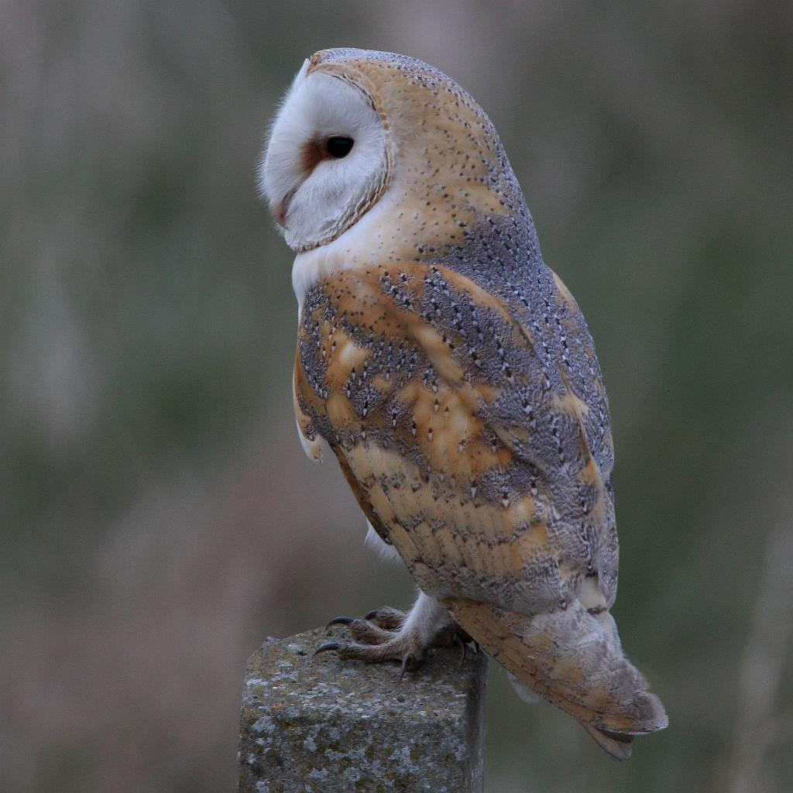
So lets take a closer look at the Barn Owl

Slide 8
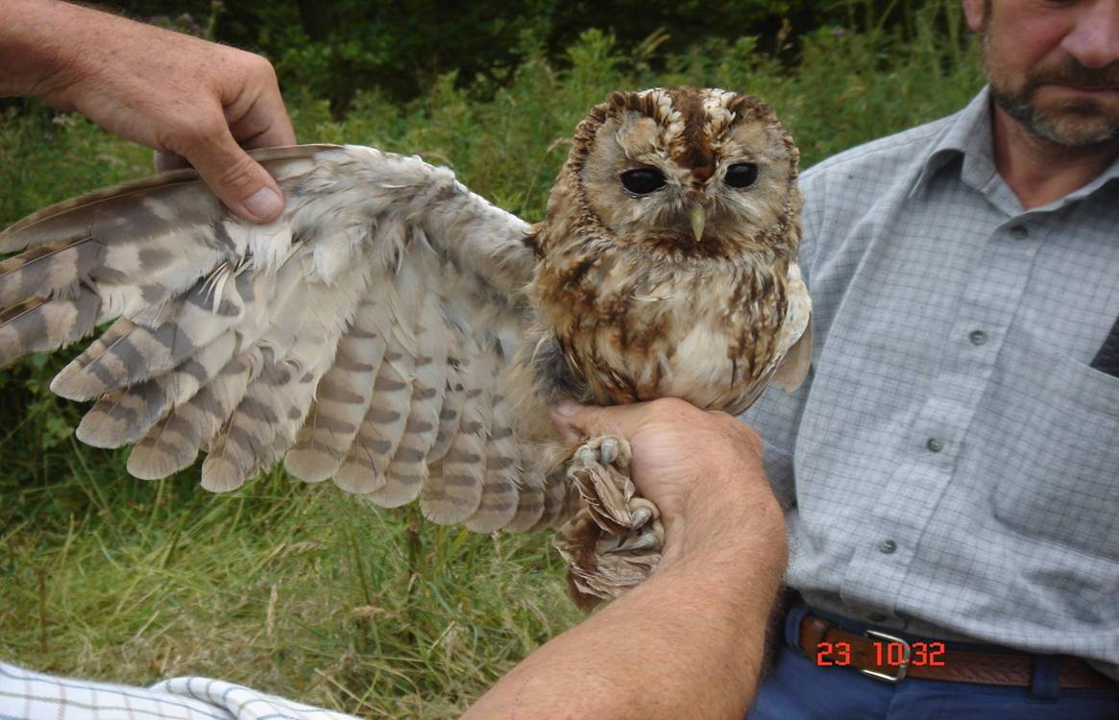
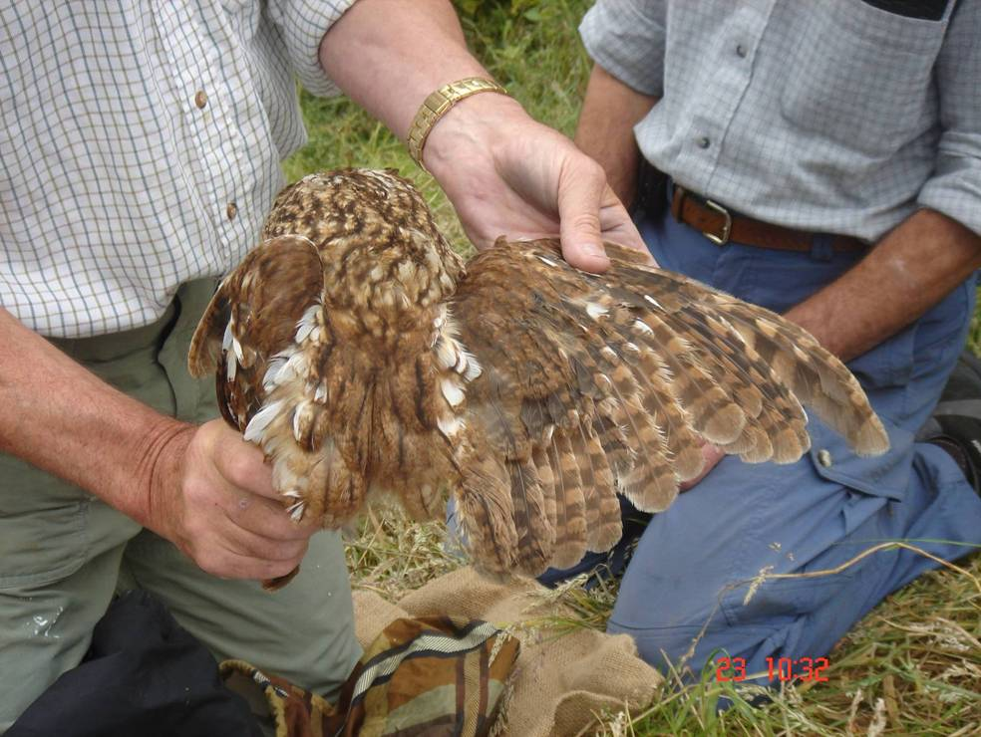
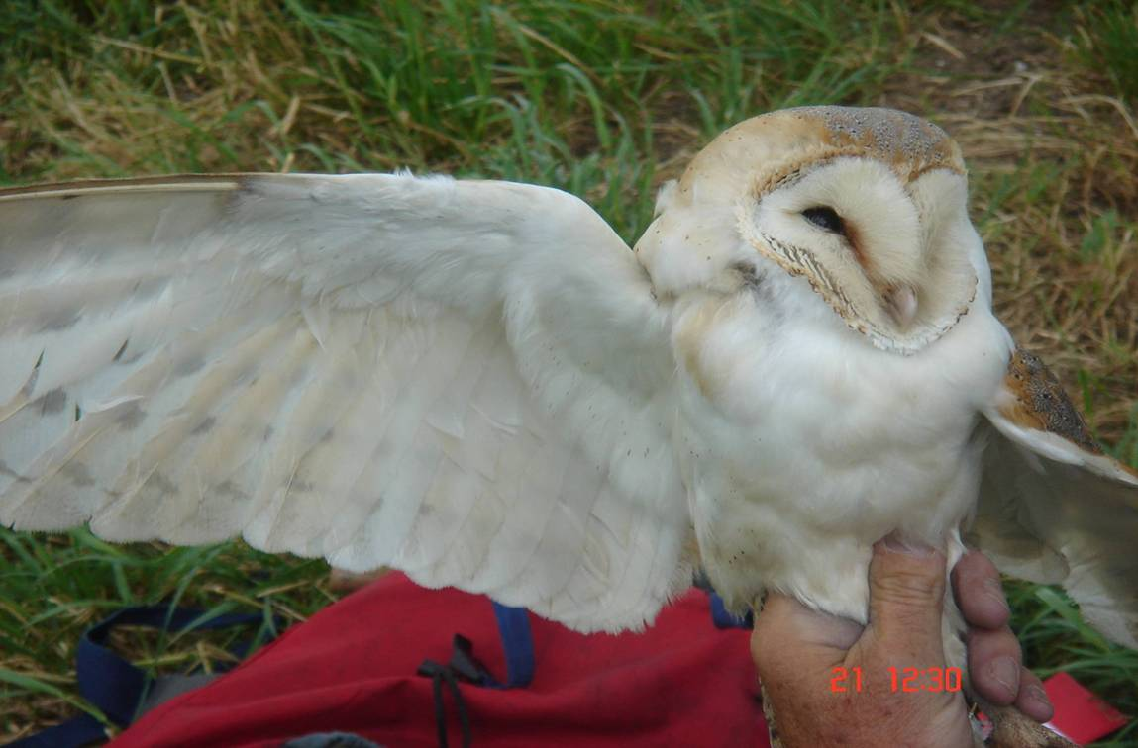
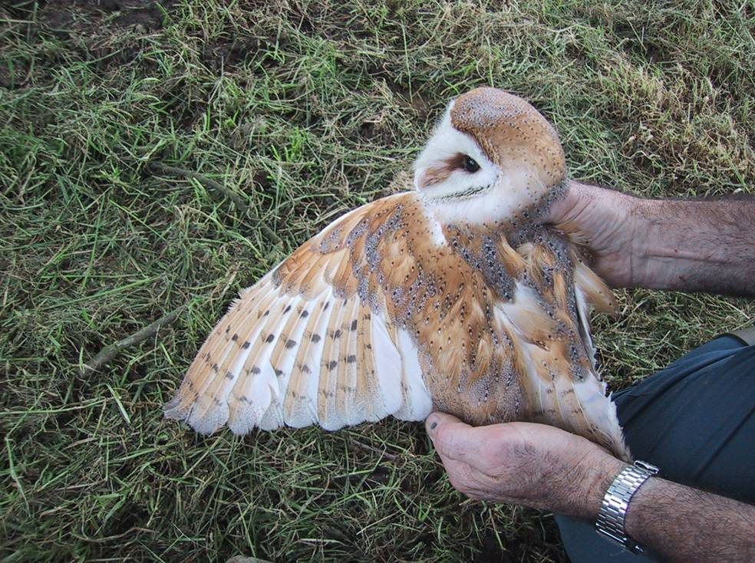

Slide 9
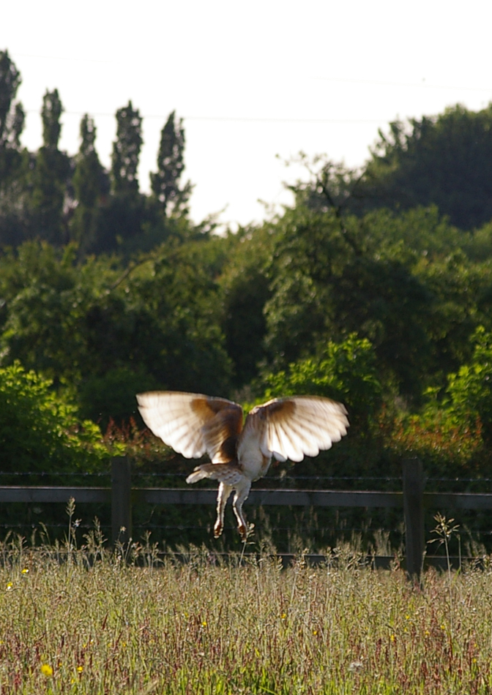

Slide 10
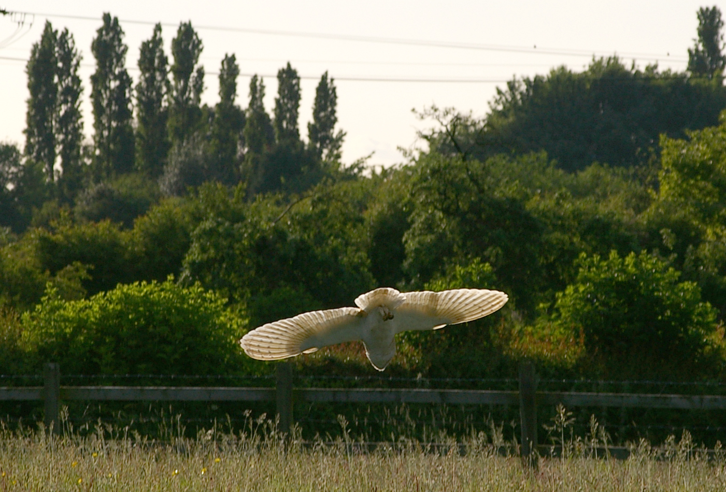
Note the large wing span

Slide 11
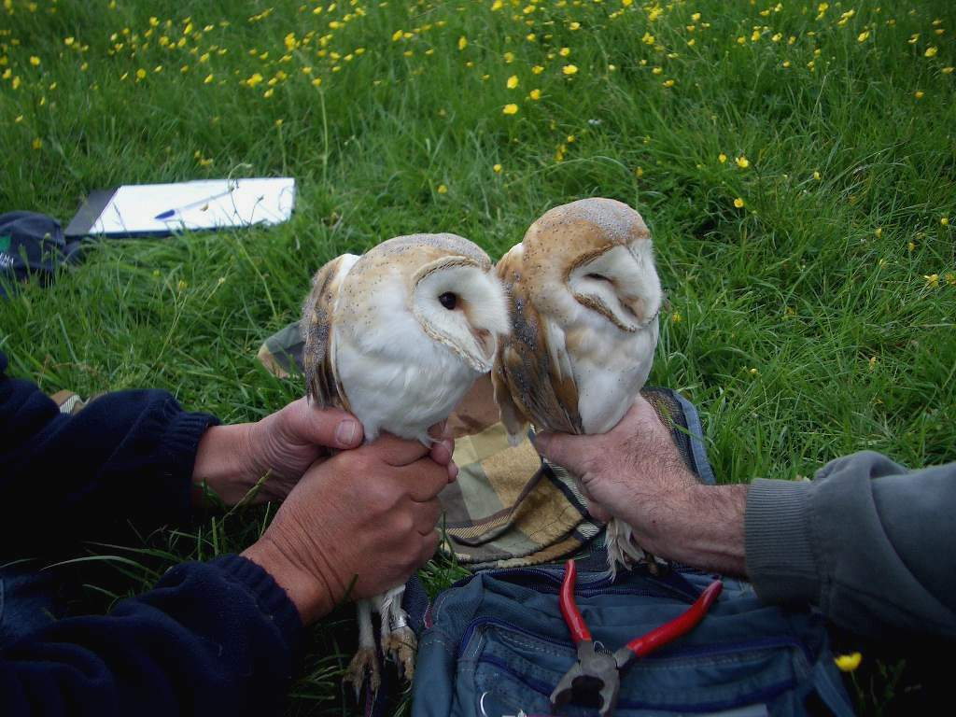

Slide 12
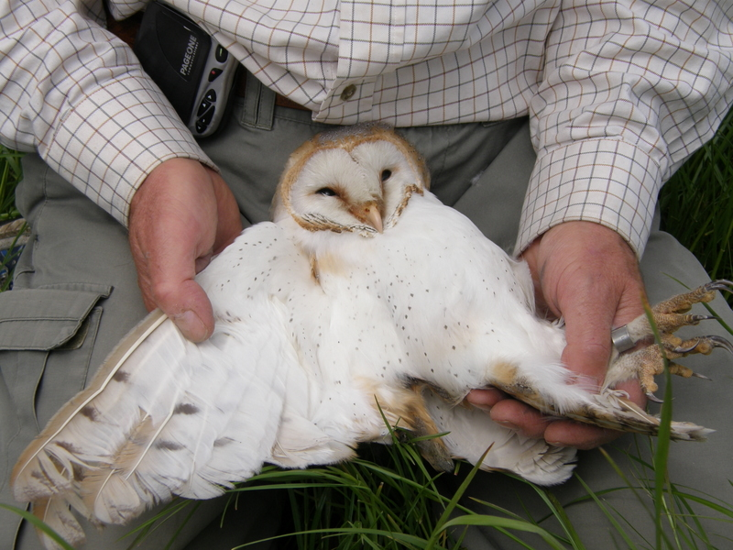

Slide 13
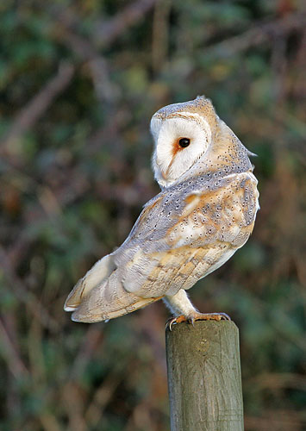
Ability to rotate their head

Slide 14
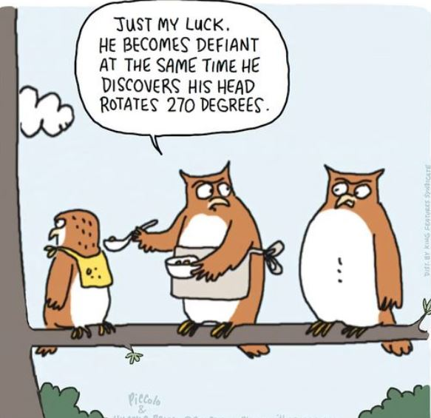

Slide 15
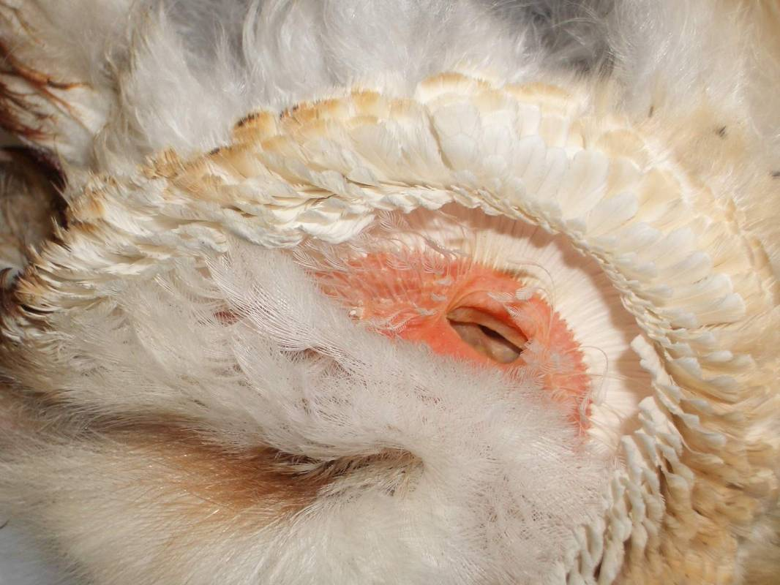

Slide 16
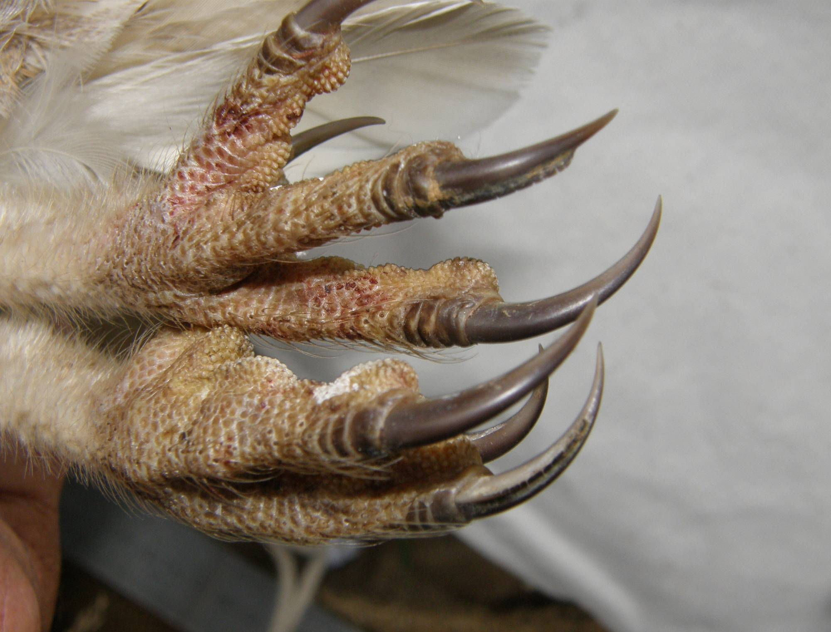

Slide 17
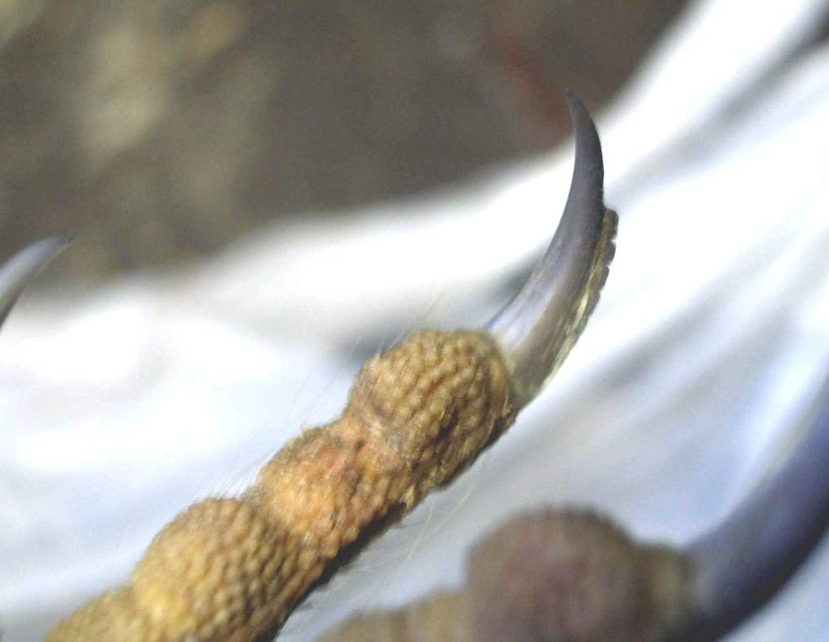
So what else do they use their talons for?

Slide 18
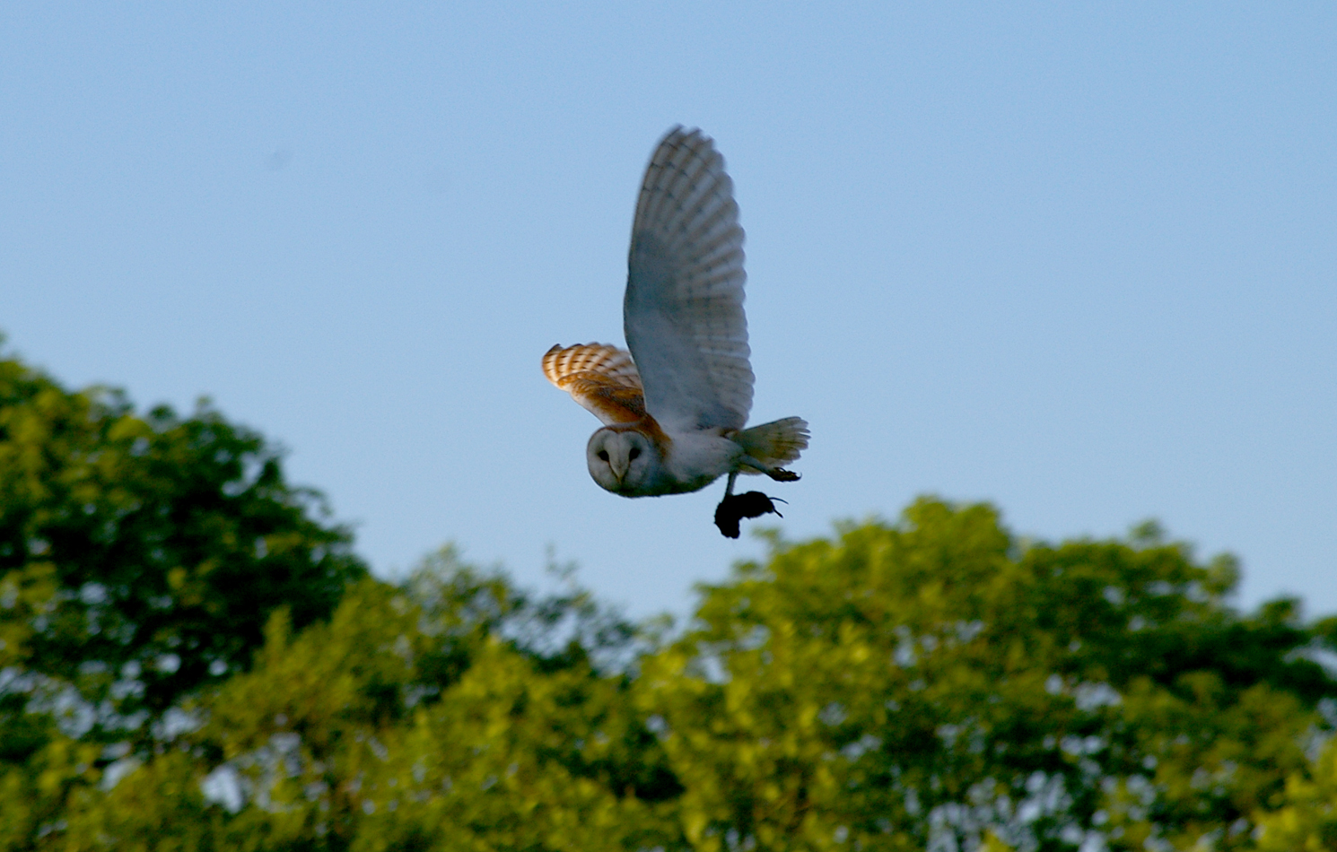

Slide 19
PREY SPECIES %
Field vole
Bank vole
Wood mouse
Common shrew
Pygmy shrew
Water shrew
others
55%
10%
10%
15%
10%

Slide 20
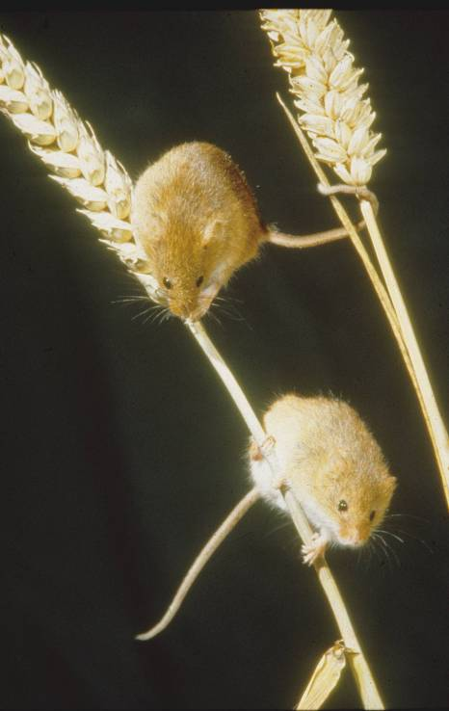
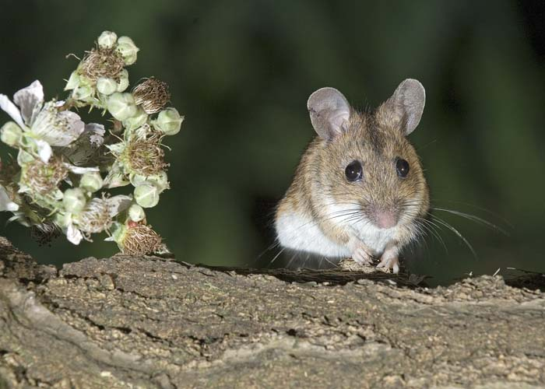
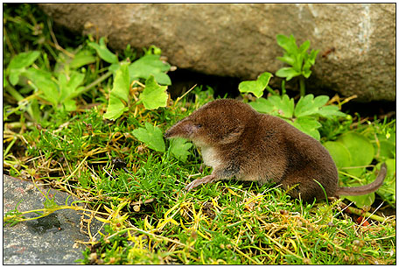
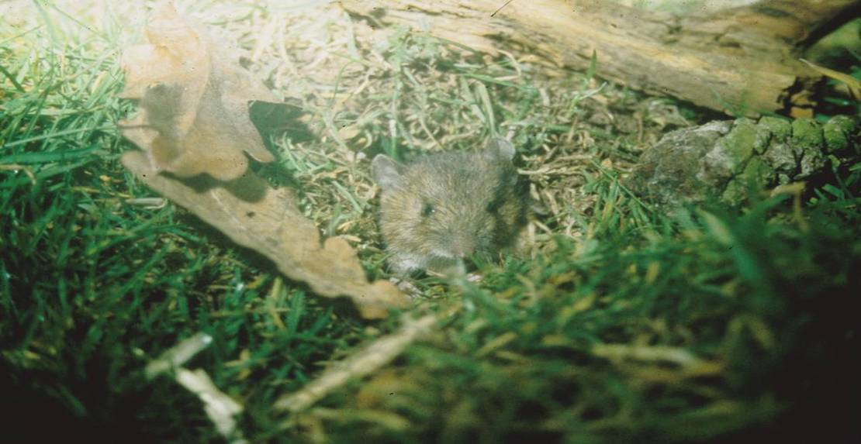
Wood Mouse
Harvest Mouse
Field Vole
Shrew

Slide 21
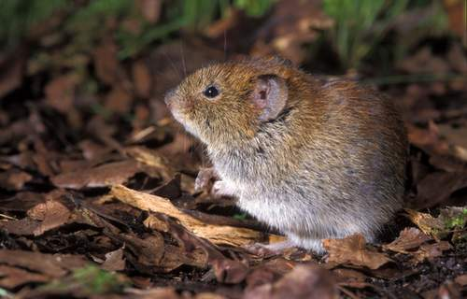
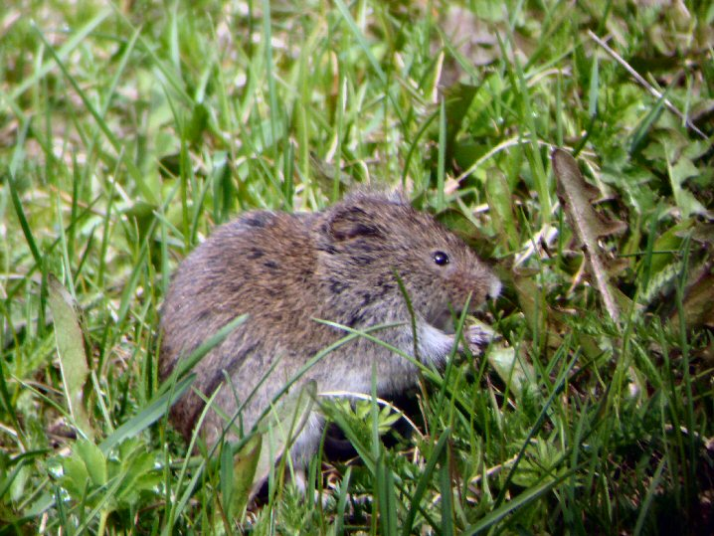
Bank Vole
Field Vole
So what happens to the prey?

Slide 22
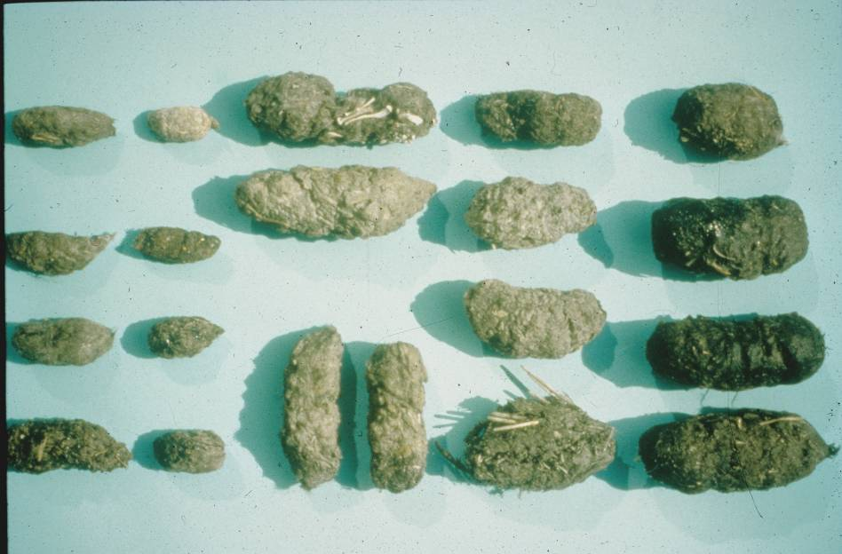
Little Owl
Long Eared Owl
Tawny Owl
Barn Owl
Kestrel
Short Eared Owl

Slide 23
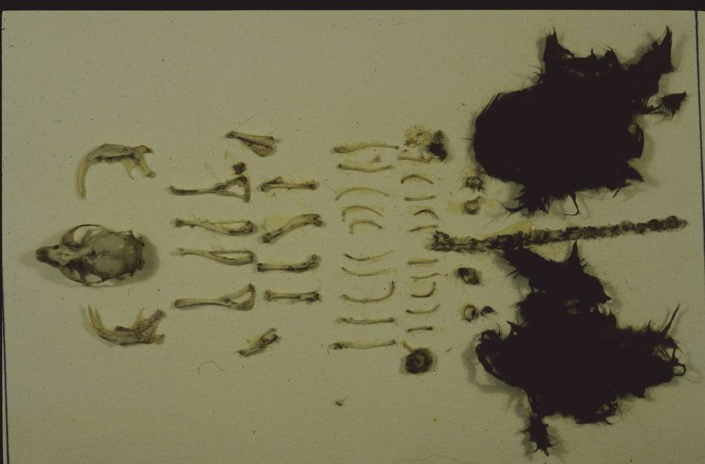

Slide 24
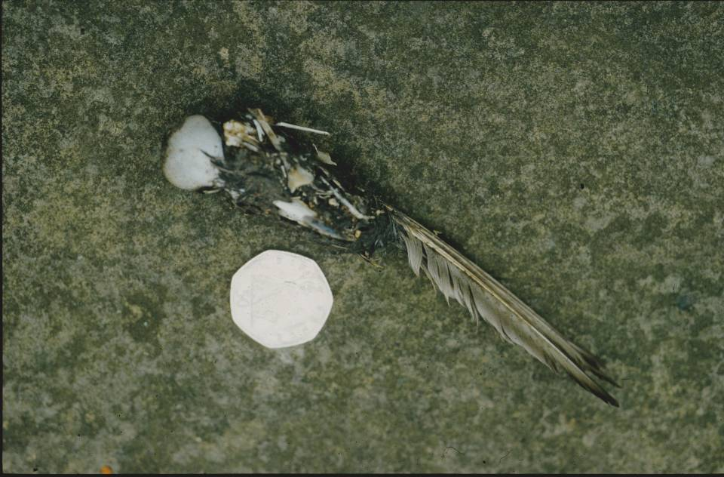

Slide 25
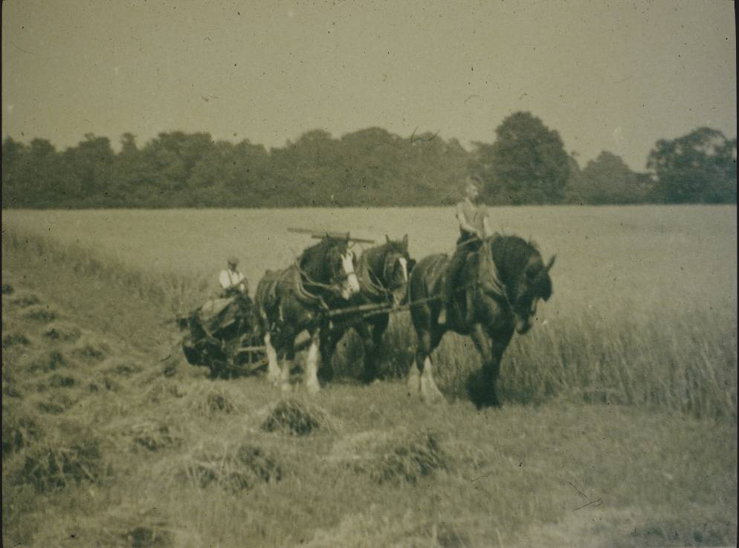
Environment

Slide 26
The breeding density and distribution of the Barn Owl in England and Wales
1932
1992

Slide 27
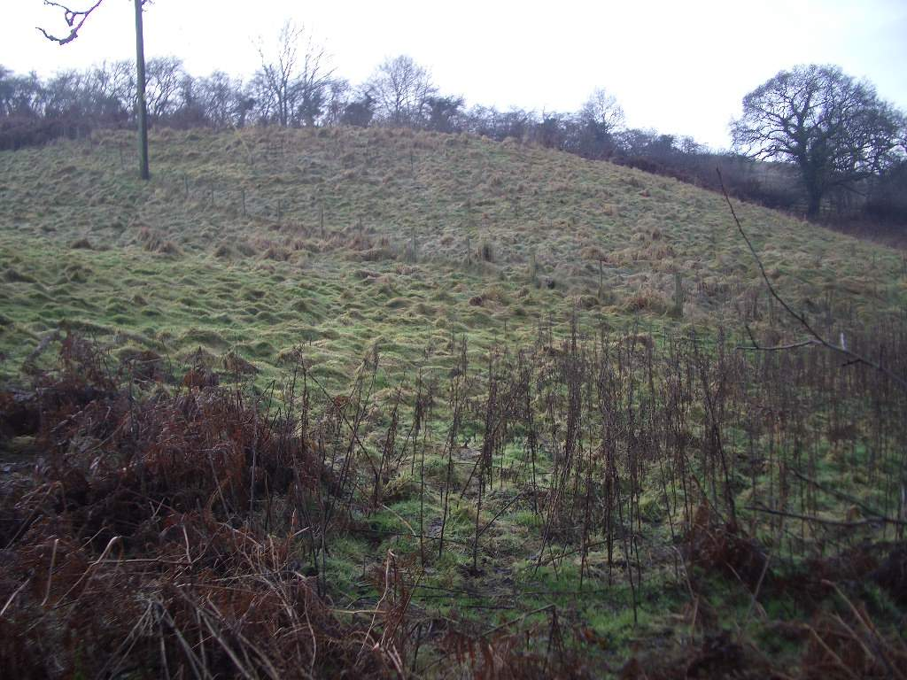

Slide 28
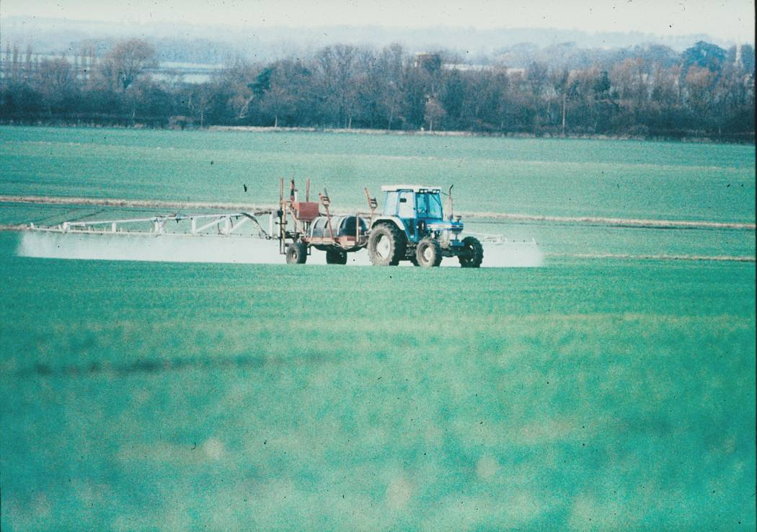

Slide 29
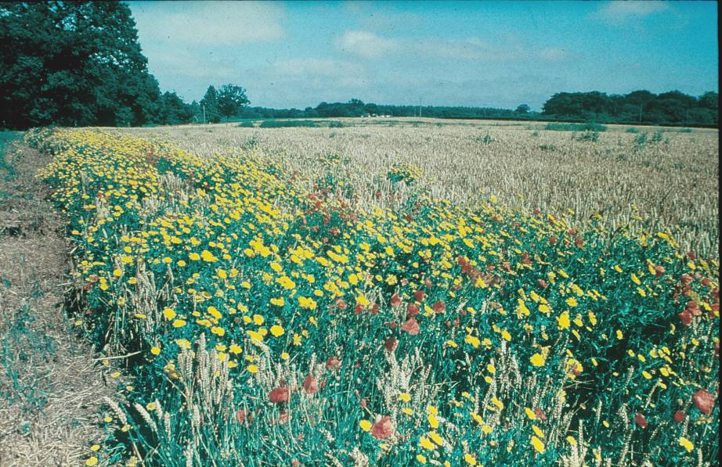
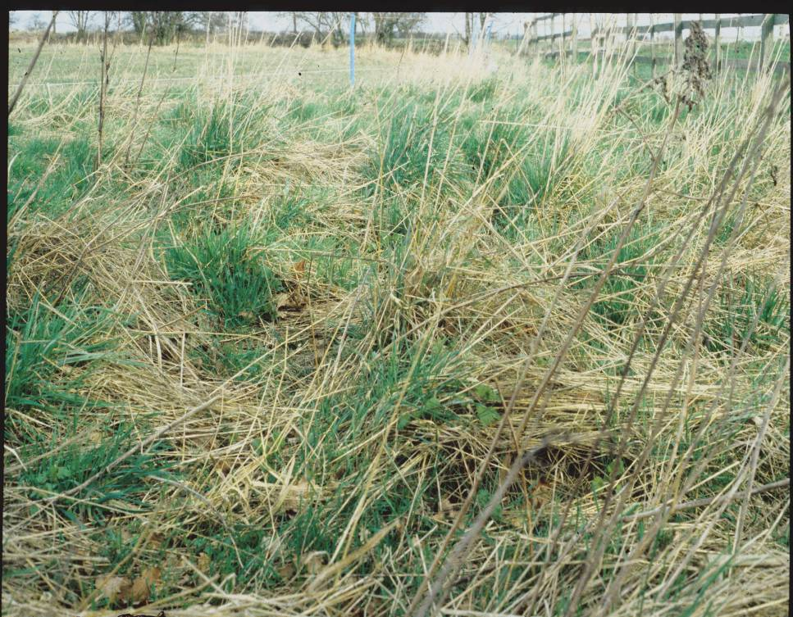

Slide 30
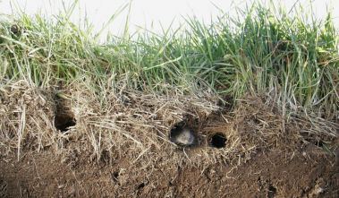

Slide 31
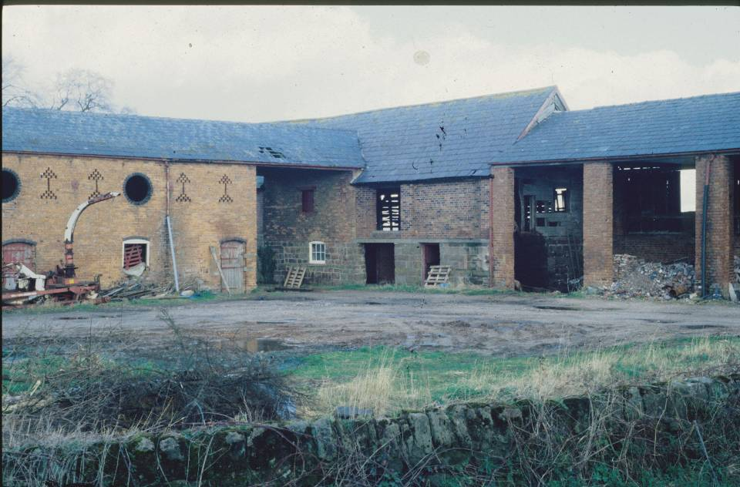

Slide 32
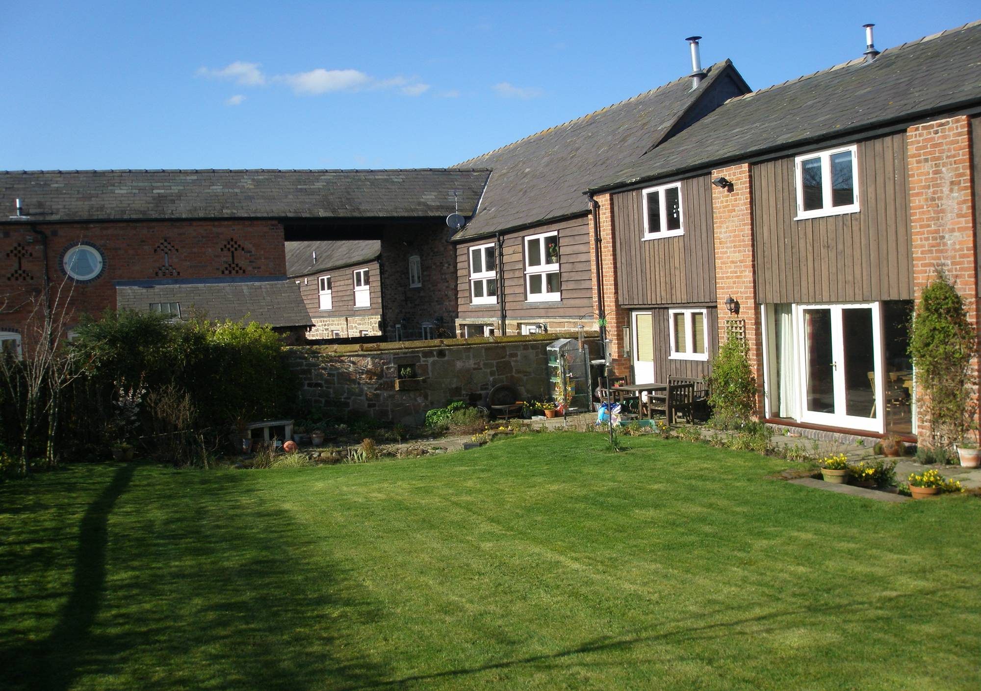
In mid 1990’s the owl population was still in serious decline due to no suitable habitat or breeding places.

Slide 33
The Broxton Barn Owl Group
(BBOG)
1993-4 survey recorded only 6 breeding pairs in Cheshire
BBOG was formed in 1995 by a group of 6 people from the Burwardsley / Broxton area
Construction & provision of homes for the Owls
Required the support of farmers and landowners

Slide 34
BBOG Objective
In partnership with the farmers and landowners, to ensure a long term future for the Barn Owl in Cheshire
All volunteers give their time and services free of charge
Funding for materials through donations and grants.
What do we get out of this?
A year in the life of BBOG member

Slide 35
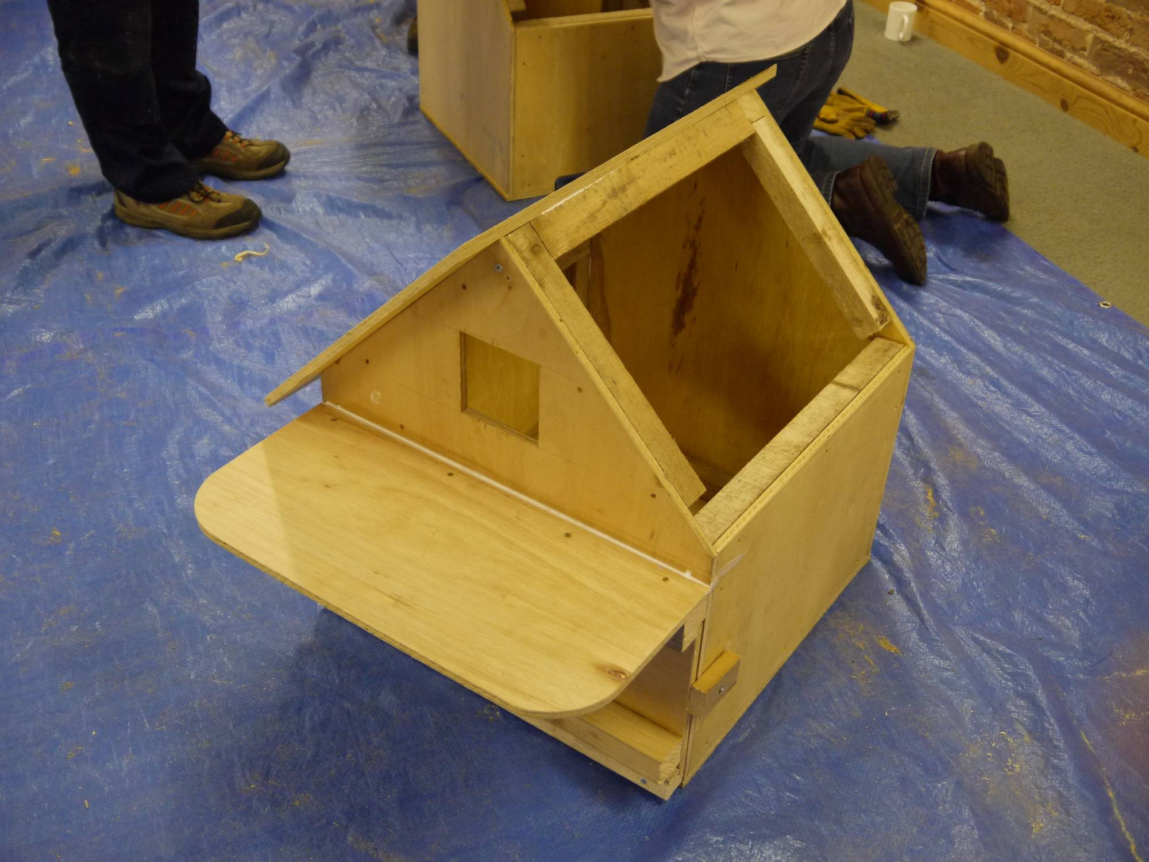

Slide 36
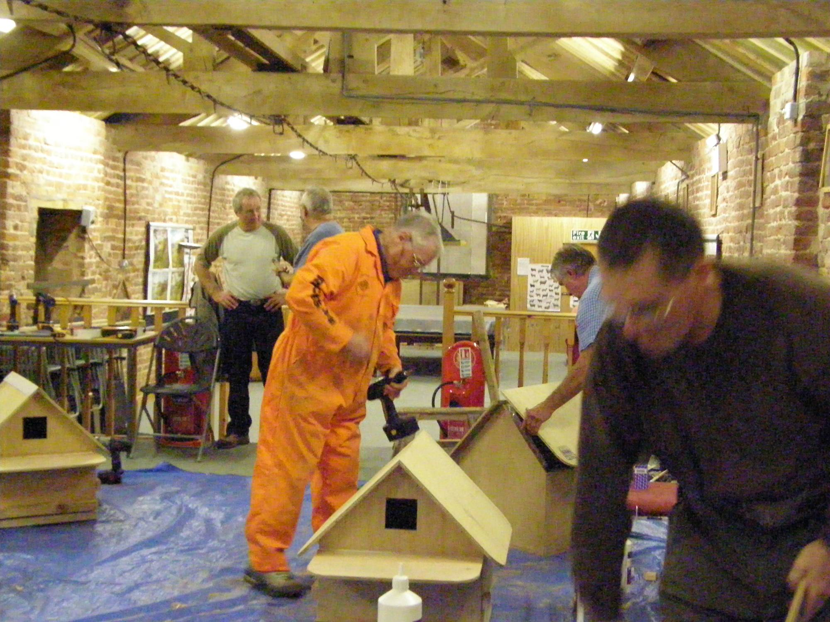

Slide 37
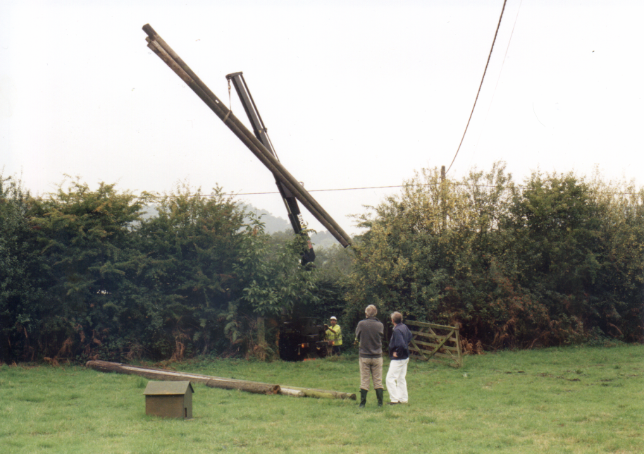
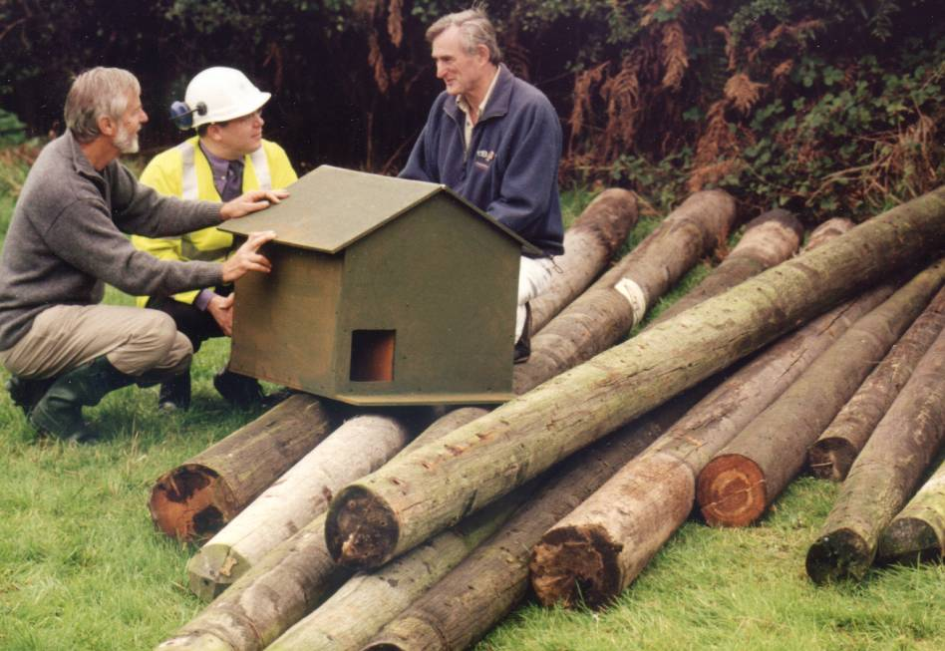

Slide 38
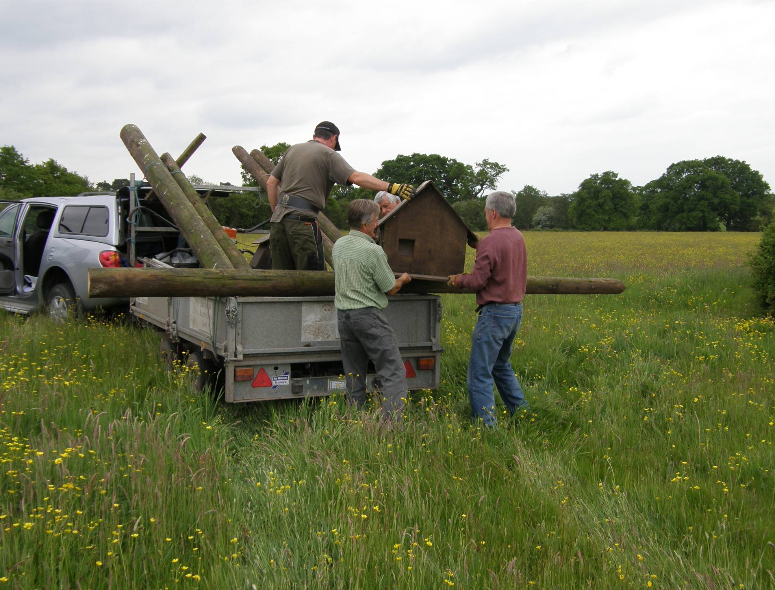
The “B” Team at work

Slide 39
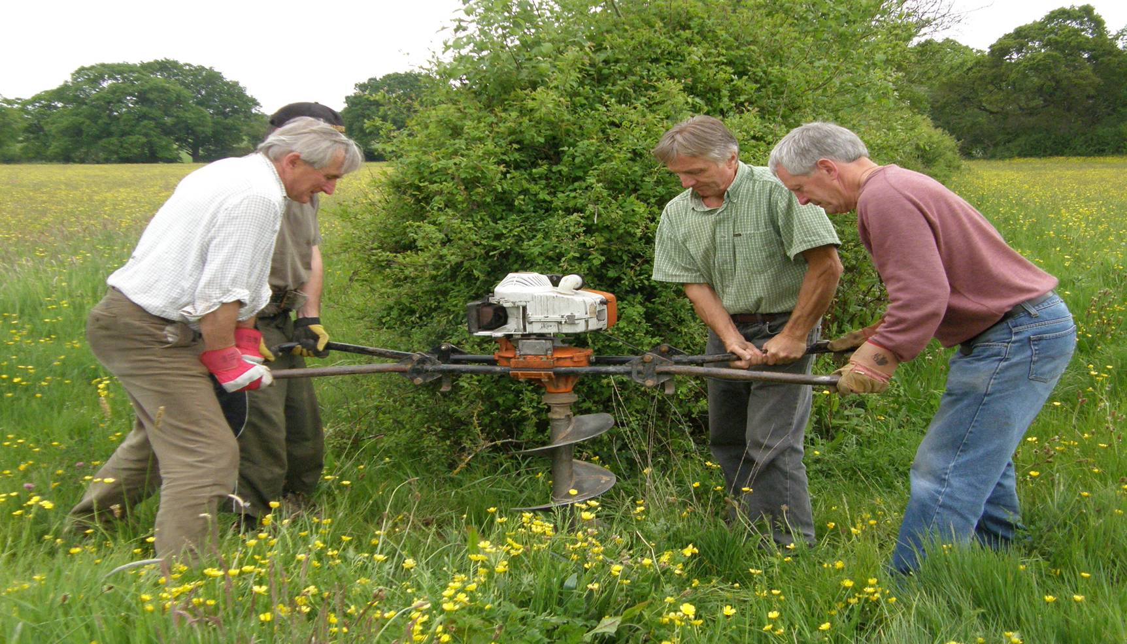
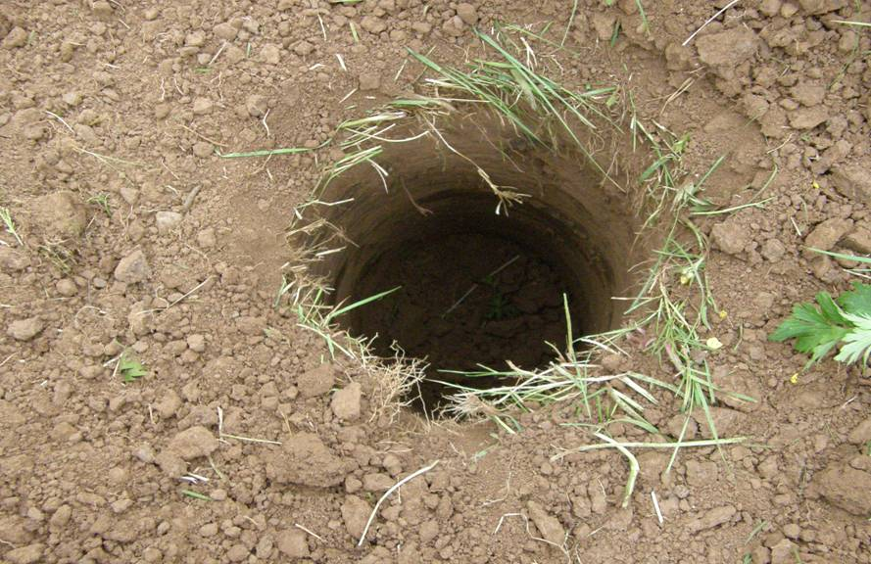

Slide 40
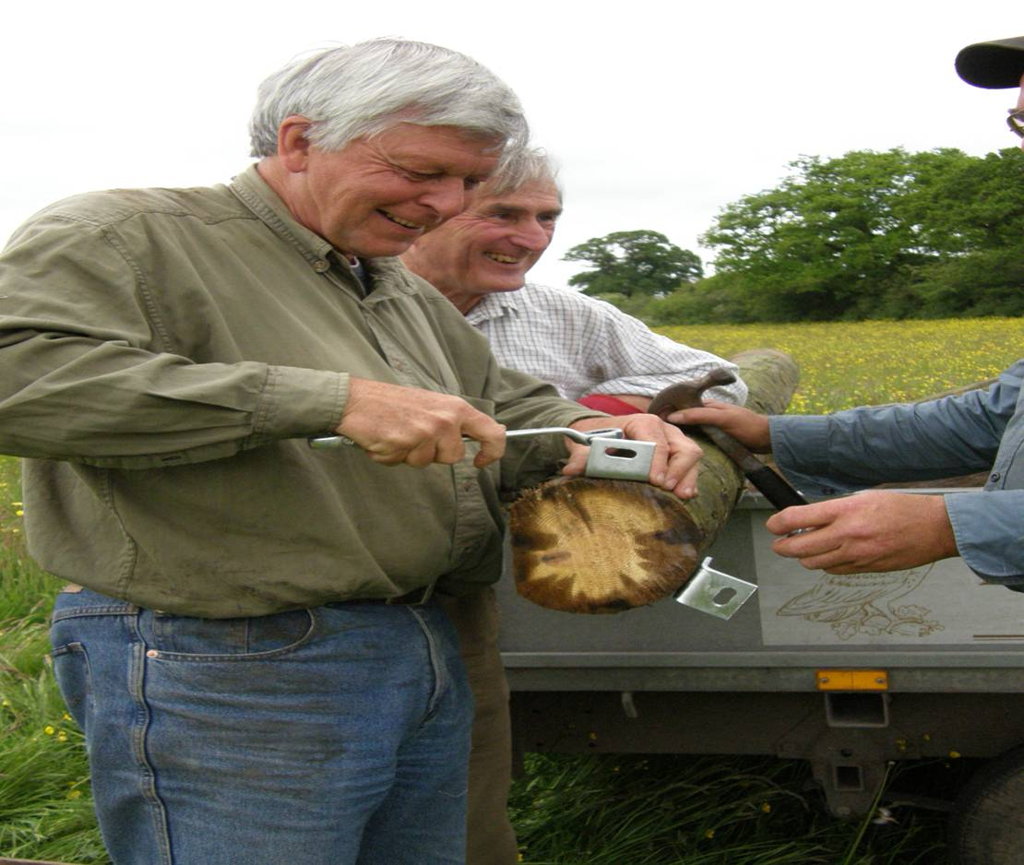
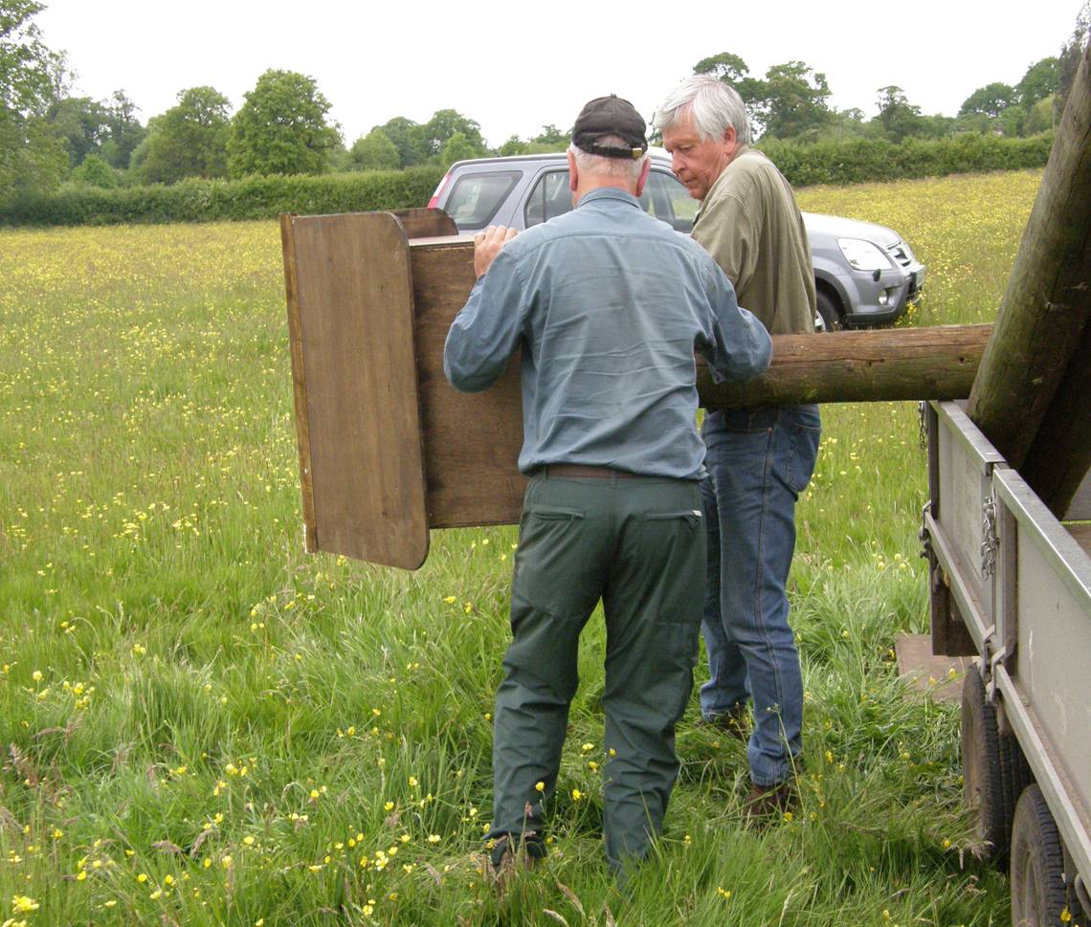

Slide 41
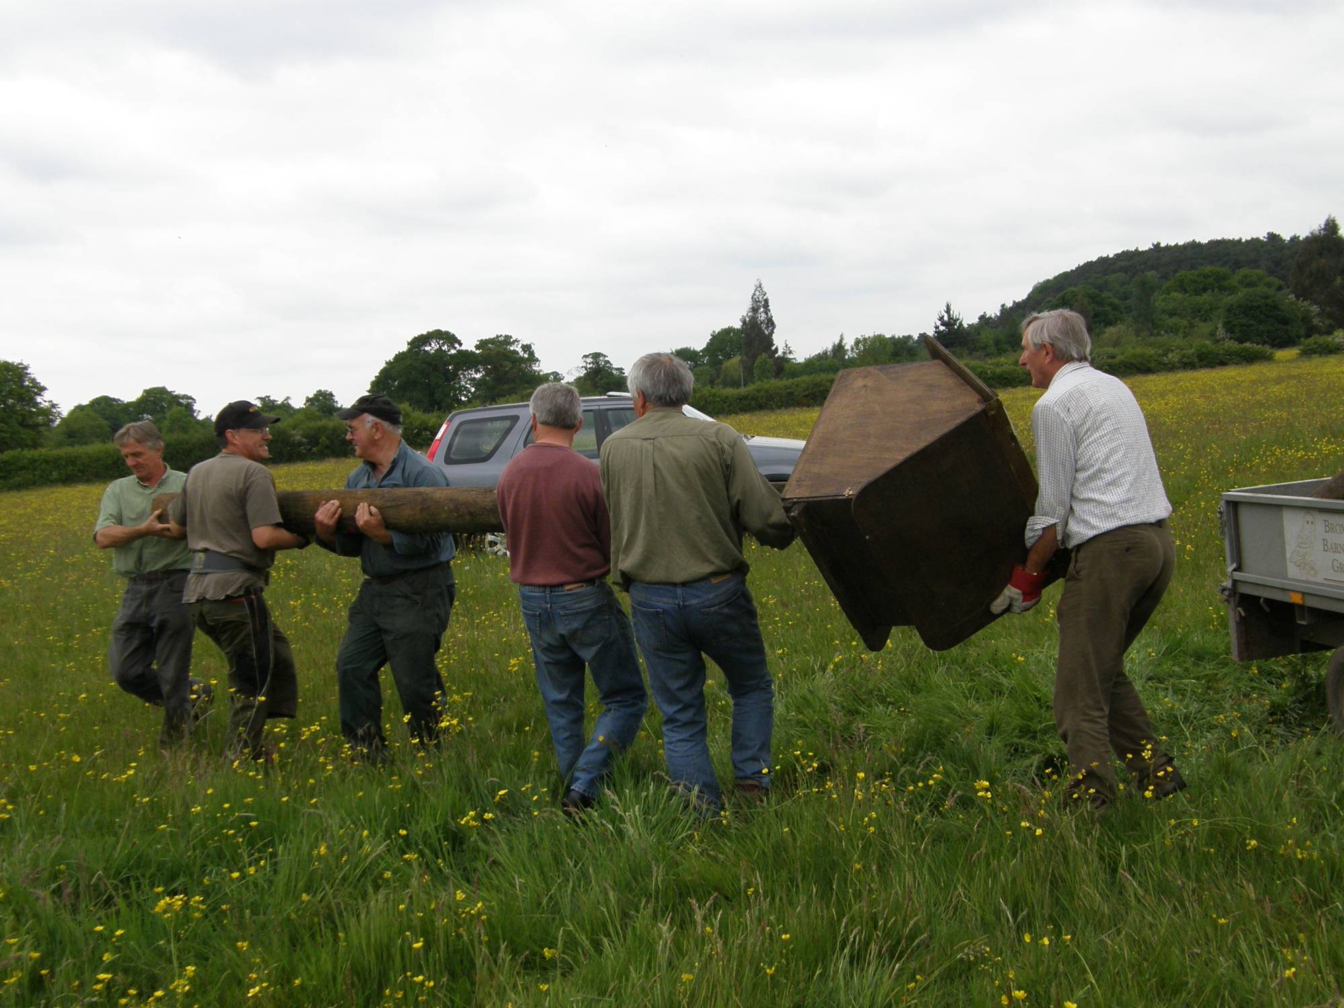

Slide 42
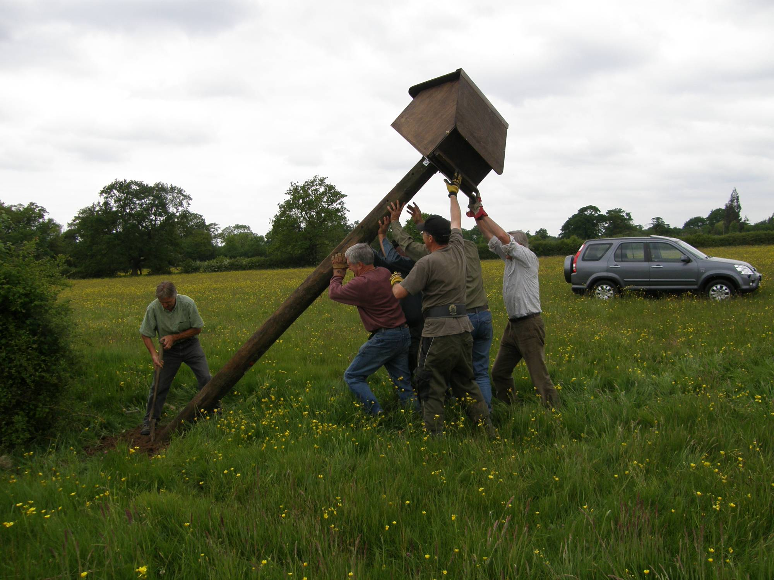

Slide 43
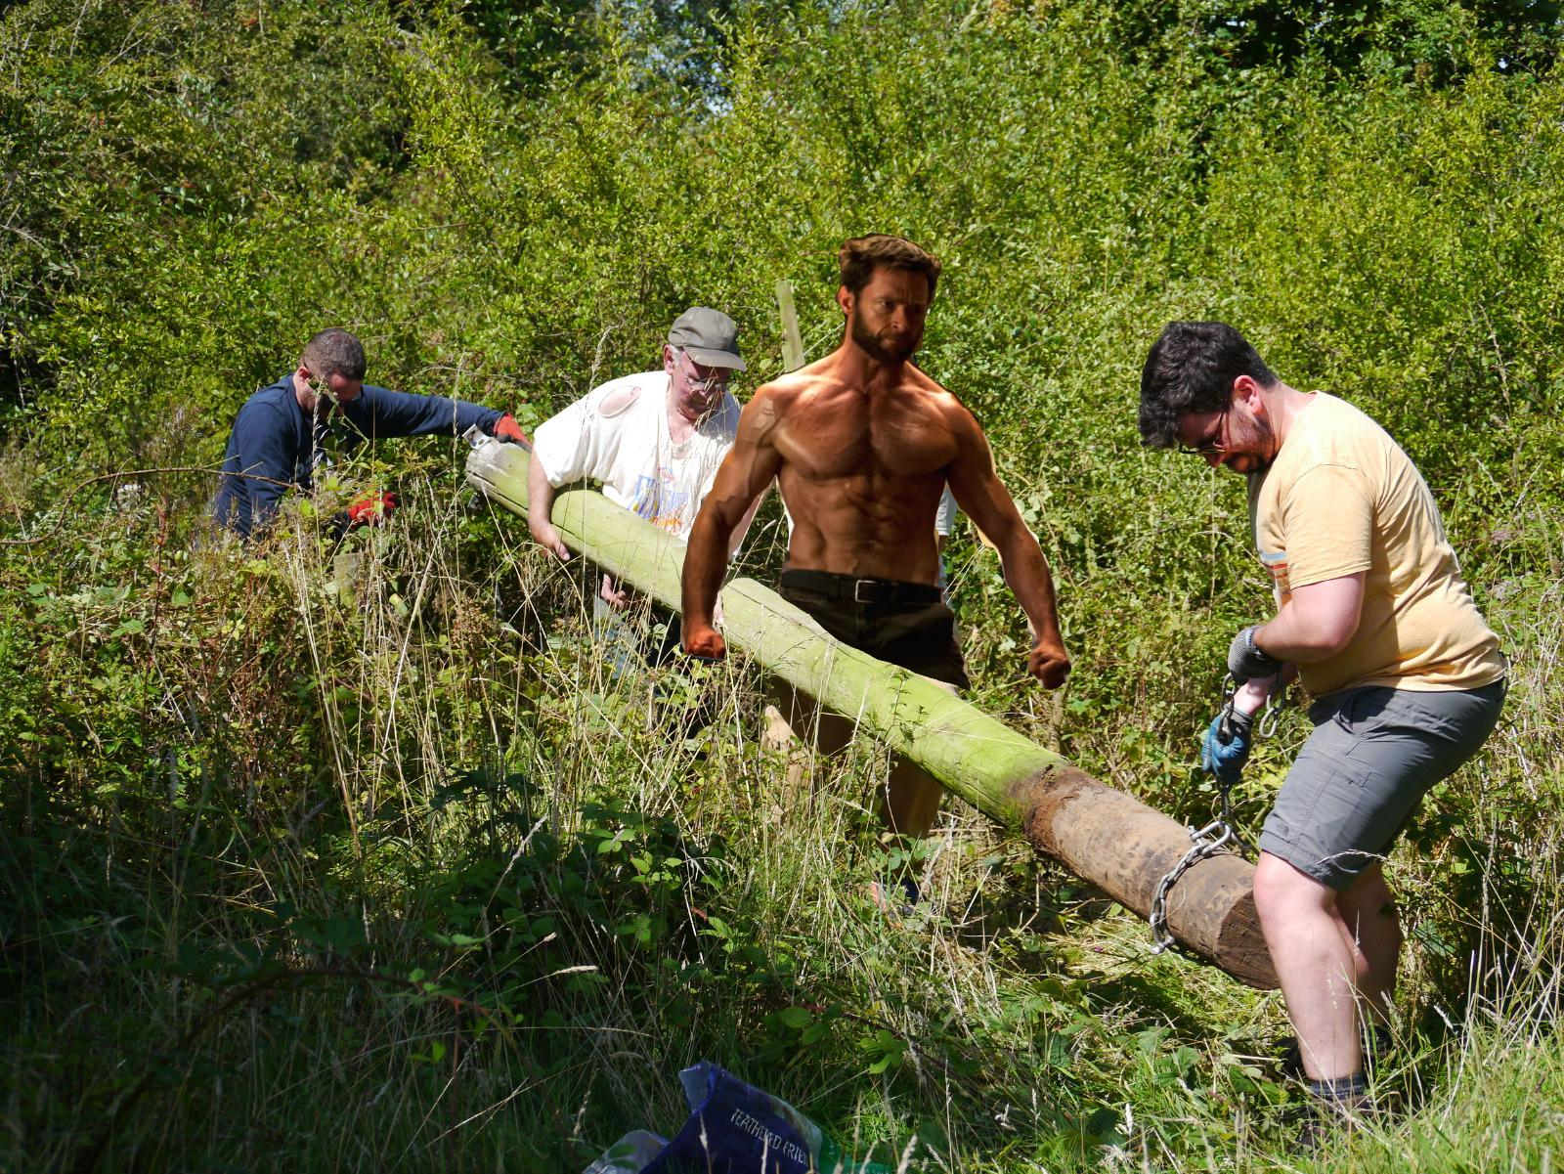

Slide 46
Quality Control

Slide 52
If we are really lucky the owls move in

Slide 55
Trapping the Owls

Slide 66
Be very aware of mother owls

Slide 68
Jackdaws
Squirrels

Slide 69
To ring or not to ring?
Buzzard
Stock Doves
Kestrels
Tawny Owls
Little Owls
Mandarin Ducks

Slide 76
Notes:
76

Slide 82
Why are we doing this work?.
Notes:
82

Slide 83
Why are we doing this work?.
Have we made a diffference?
Notes:
83

Slide 84
Why are we doing this work?.

Slide 85
Have we made a difference?
Cheshire Summary
We believe we are making a difference, but there is still more to do

Slide 86
Pulli Ringed
Autumn 2010 Review
We believe we are making a difference, but there is still more to do
Finally…

Slide 87
Autumn 2015 Review
We believe we are making a difference, but there is still more to do
Finally…

Slide 88
Summary of Breeding Survey
 | 2018 | 2017 | 2016 | 2015 | 2014 | 2013 | 2012 | 2011 | 2010 | 2009 | 2008 | 2007 | 2006 | 2005 | 2004
Barn Owls:
pulli ringed | 105 | 137 | 120 | 62 | 180 | 13 | 198 | 116 | 97 | 127 | 61 | 165 | 14 | 130 | 74
Total nest sites | 44 | 49 | 44 | 32 | 40 | 4 | 66 | 38 | 41 | 43 | 28 | 35 | 5 | 38 | 36
Pulli /nest | 2.4 | 2.8 | 2.7 | 2 | 4.5 | 3.2 | 3 | 3.05 | 2.3 | 3 | 2.2 | 4.7 | 2.8 | 3.4 | 2
*Total no Boxes | 500 | 472 | 467 | 457 | 443 | 430 | 424 | 405 | 397 | 326 | 303 | 270 | 227 | 194 | 178
adults ringed | 13 | 11 | 10 | 18 | 27 | 20 | 15 |  | 23 | 12 | 12 | 12 | 17 | 18 | 13
adults retrapped | 12 | 13 | 13 | 18 |  |  | 24 | 14 | 26 | 22 | 20 | 10 | 6 | 9 | 6
Other Species:
Kestrel pulli ringed | 27 | 35 | 19 | 22 | 20 |  | 31 | 37 | 28 | 48 | 25 | 59 | 17 | 59 | 35
Kestrel adults ringed |  | - | 1 |  |  |  | 2 | 0 | 2 | 6 | 0 | 3 | 1 | 2 | 0
Kestrel breeding sites |  | 10 | 6 | 6 | 6 |  | 10 | 10 | 11 | 11 | 8 | 17 | 7 | 17 | 11
Kestrel pulli/nest |  | 3.5 | 3.2 | 3.7 | 3.3 |  | 3.1 | 3.7 | 3 | 4.4 | 3.1 | 3.5 | 2.4 | 3.5 | 3.2
Stock doves Jackdaws |  |  |  |  |  |  |  |  | Lots more ! | Lots! |  |  |  | 1 | 2
 |  |  | 2
Little Owl pulli |  |  | - | - | - |  |  | 0 | 7 | 5 | 3 |  |  | 3
Tawny Owl | 2 | 3 | 4 | 3 | 8 |  |  | 3 | 3 | 3 | 1 | 1 | 2
Tawny Nests | 1 | 1 | 2 | 1 | 2 |  |  | 1 | 1 | 1
interim 2017 barn owl breeding stats for Cheshire:
 |  | nest sites | pulli
Mid Chesh |  | 102 |  | 220
Wirral |  | 36 |  | 82
BBOG |  | 49 |  | 137
Totals |  | 187 |  | 439

Slide 89
Our own Barn Owls
www.bbog.co.uk

Slide 91
Any questions?

