Slide 1
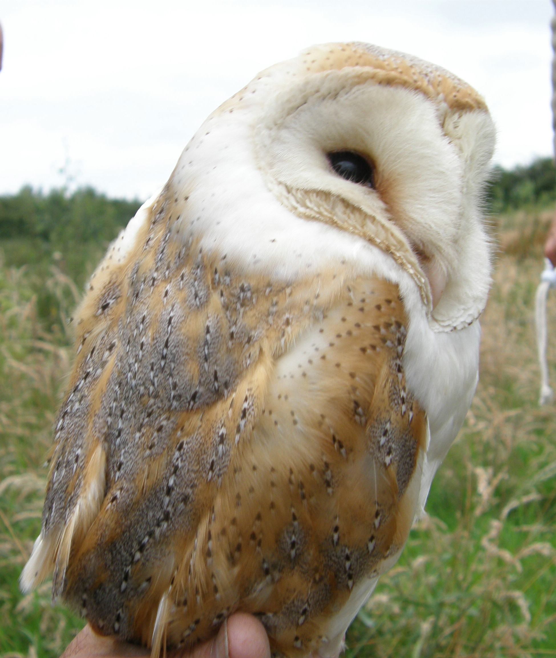
The Barn Owl
WELCOME
Steven Prince / Chris Whitehurst
Broxton Barn Owl Group (BBOG)
Notes:
1

Slide 2
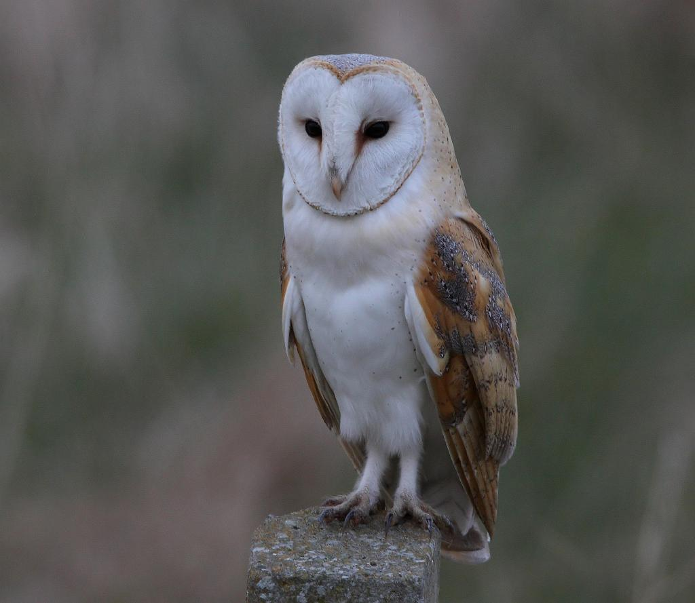
The Barn Owl
(Tyto alba)
What do they sound like?

Slide 3
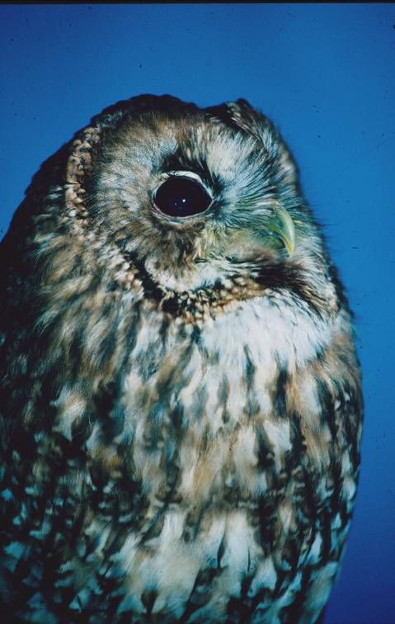


Slide 4
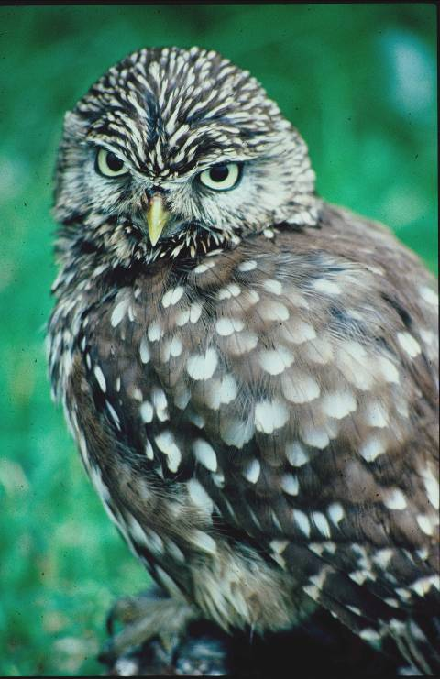

Slide 5
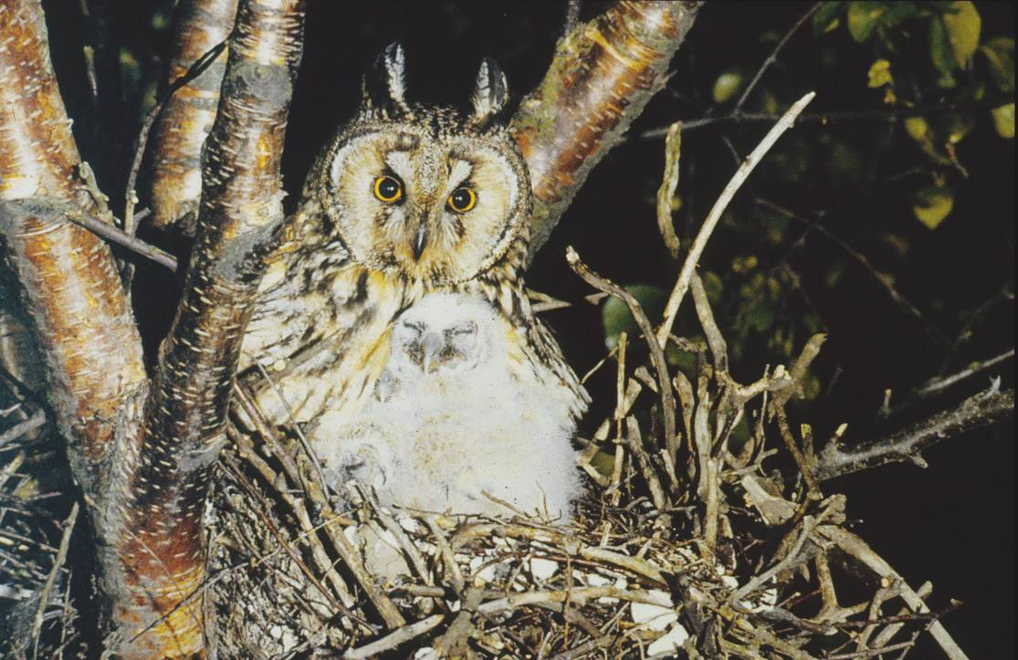

Slide 6
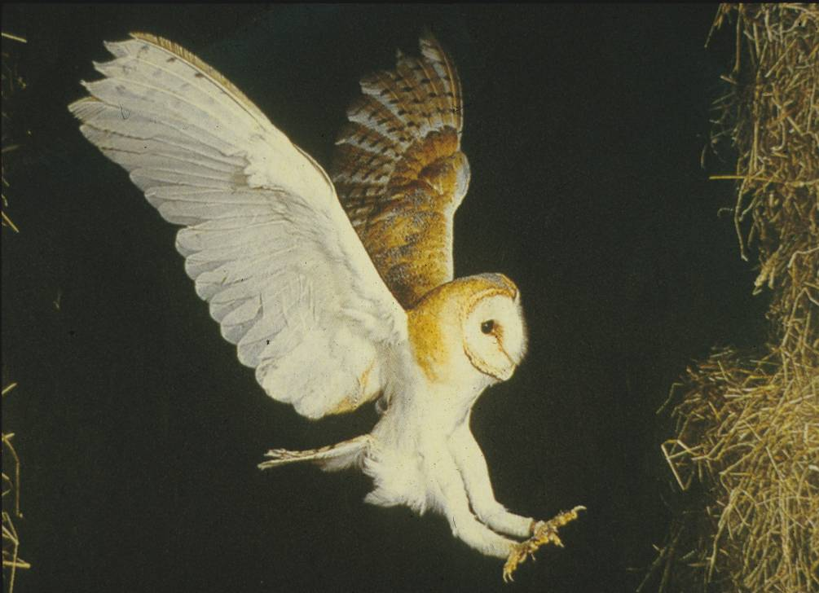


Slide 7
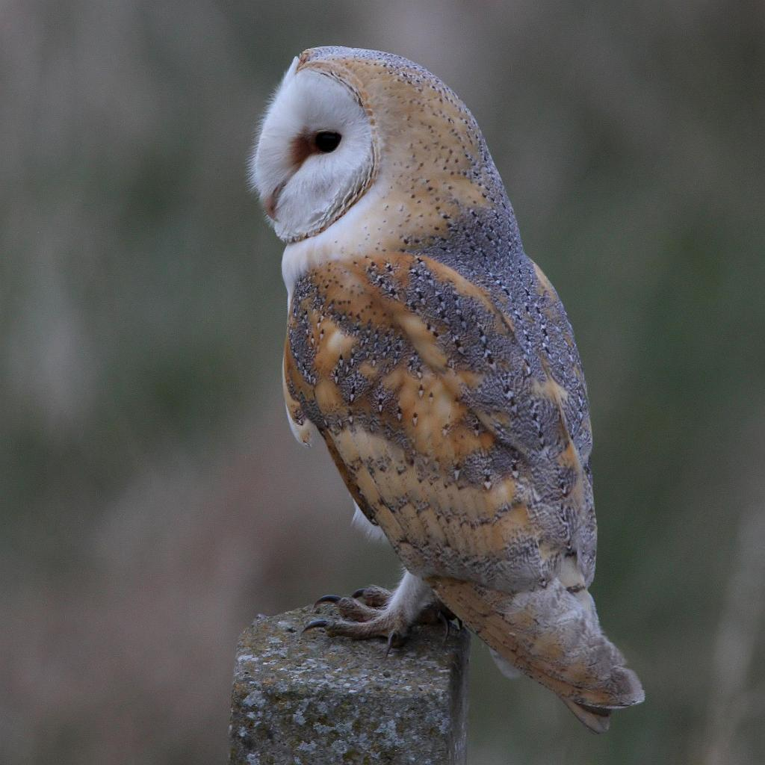
So lets take a closer look at the Barn Owl

Slide 8
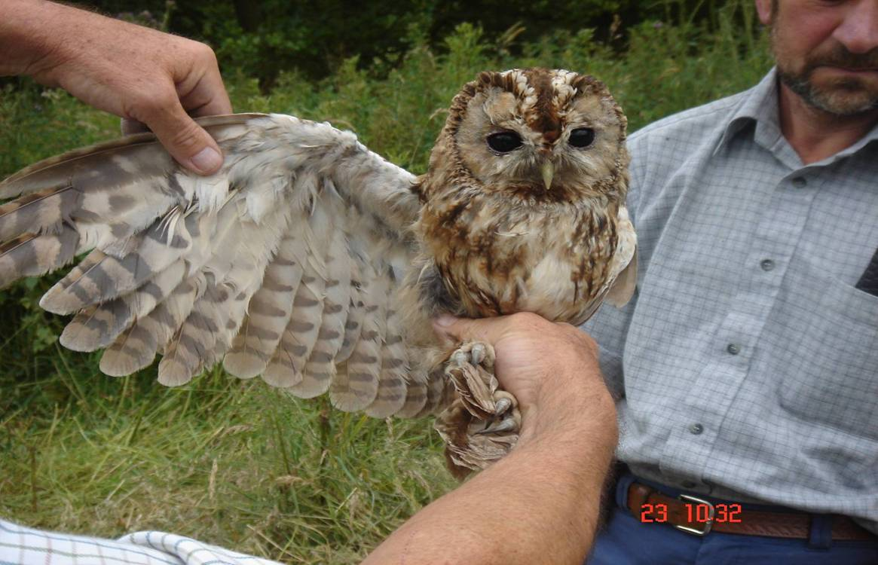
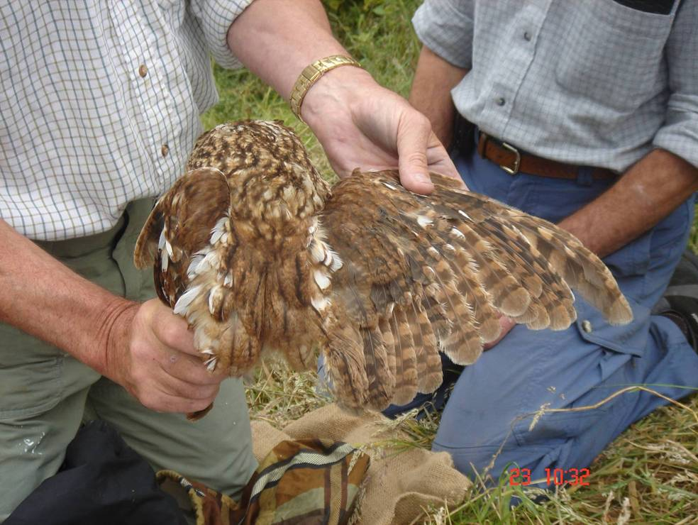
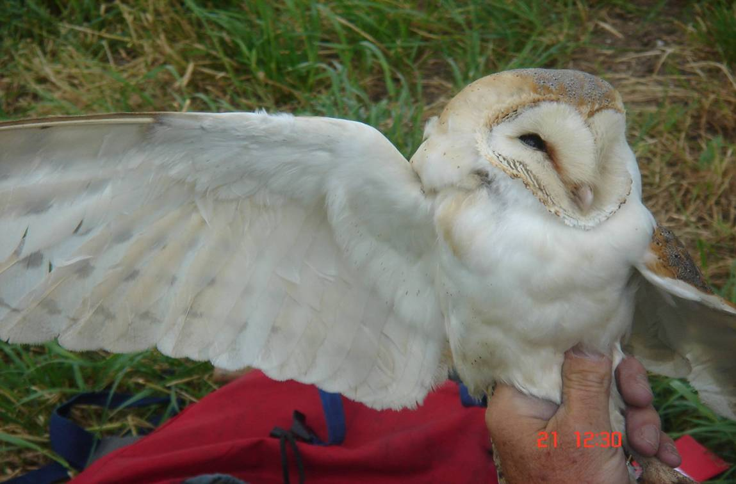
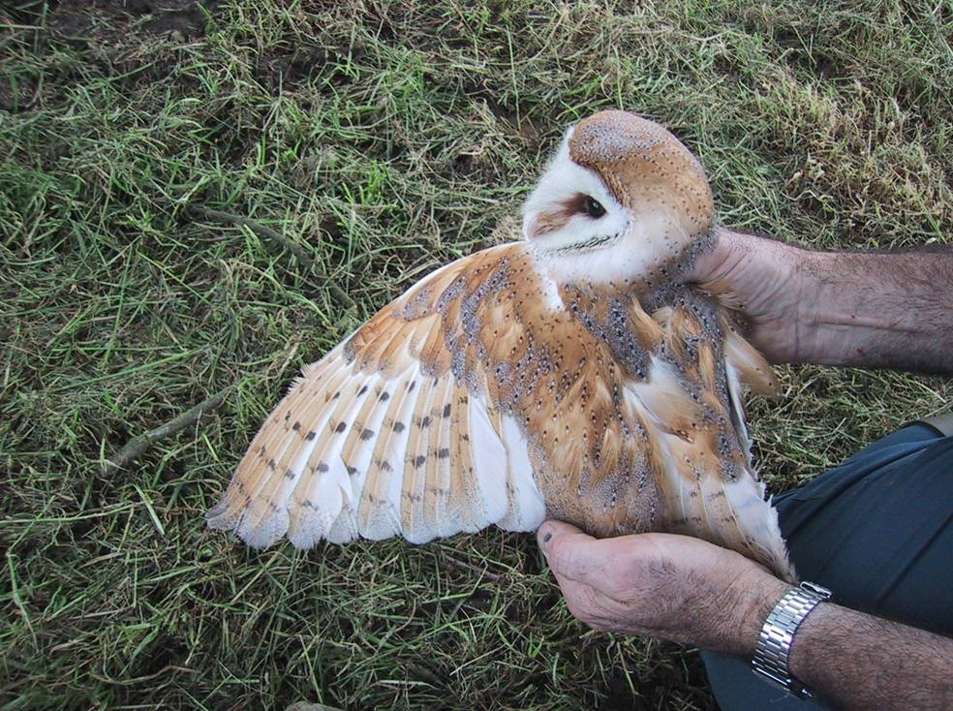

Slide 9
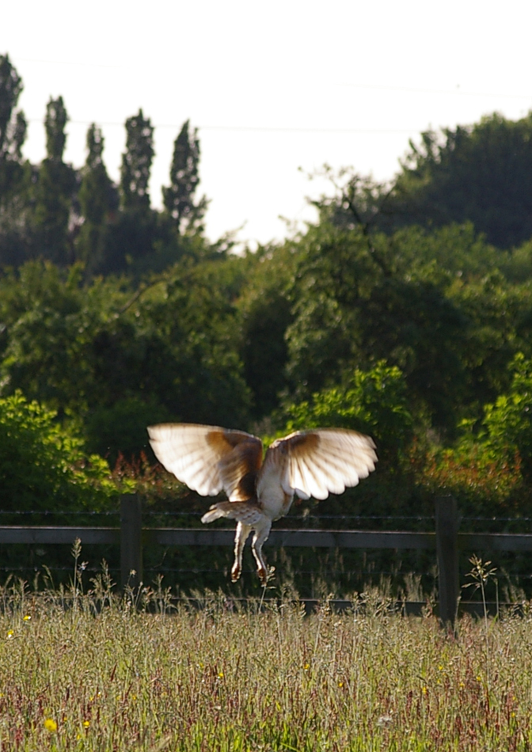

Slide 10
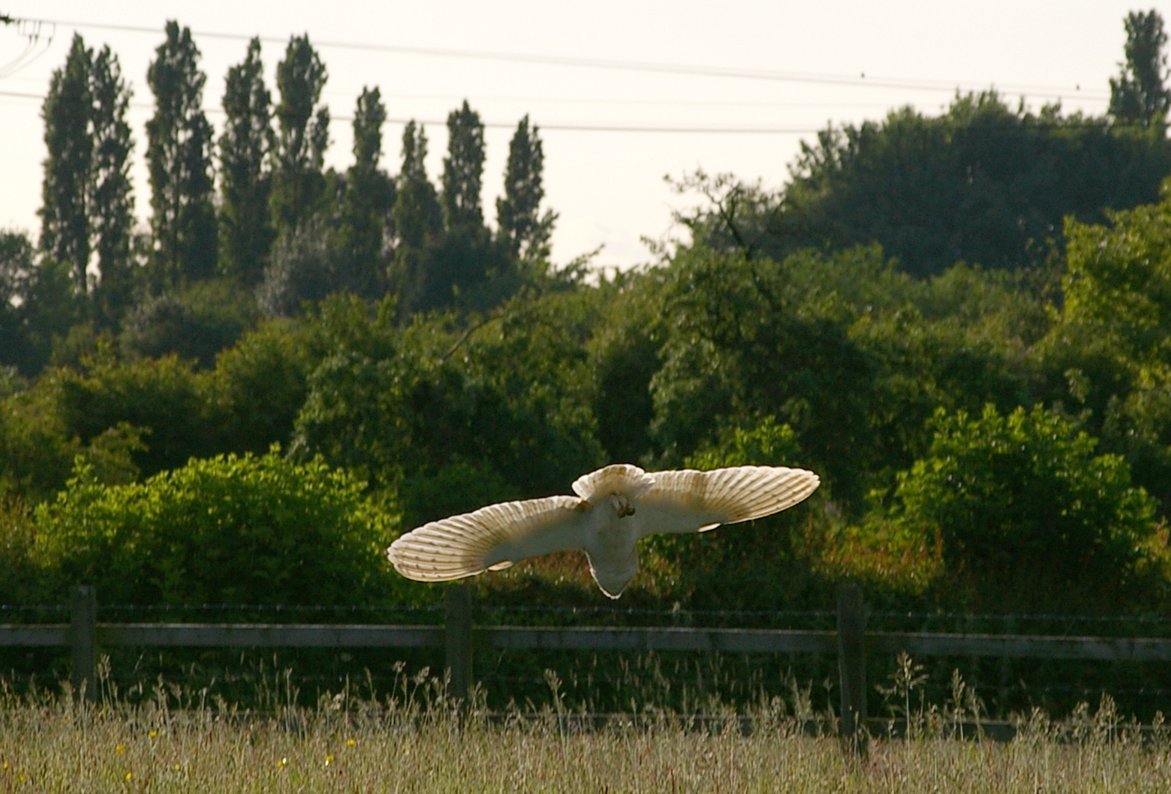
Note the large wing span

Slide 11
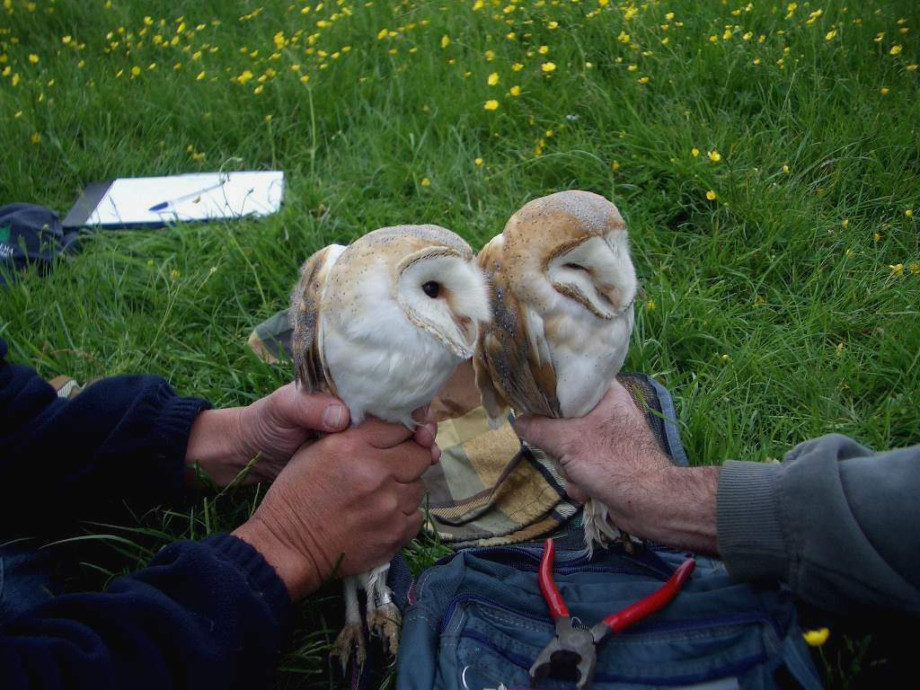

Slide 12
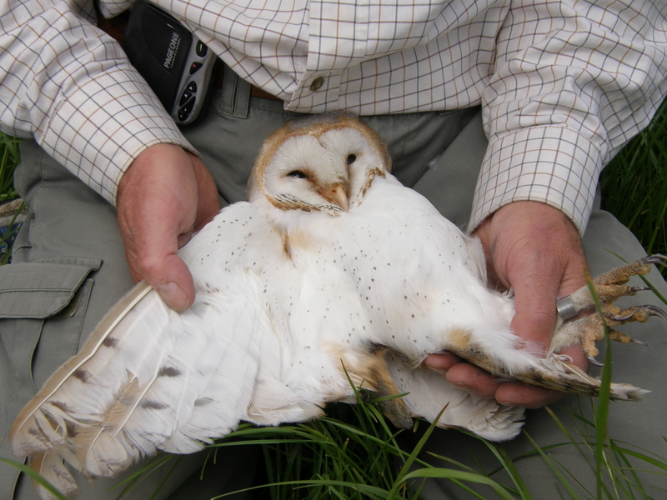

Slide 13
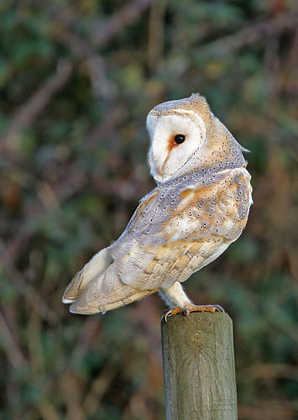
Ability to rotate their head

Slide 14
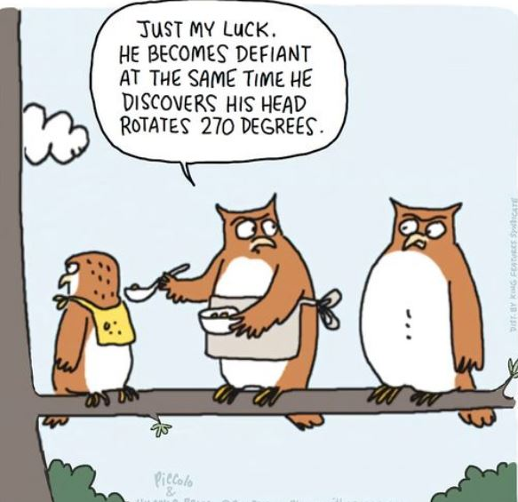

Slide 15
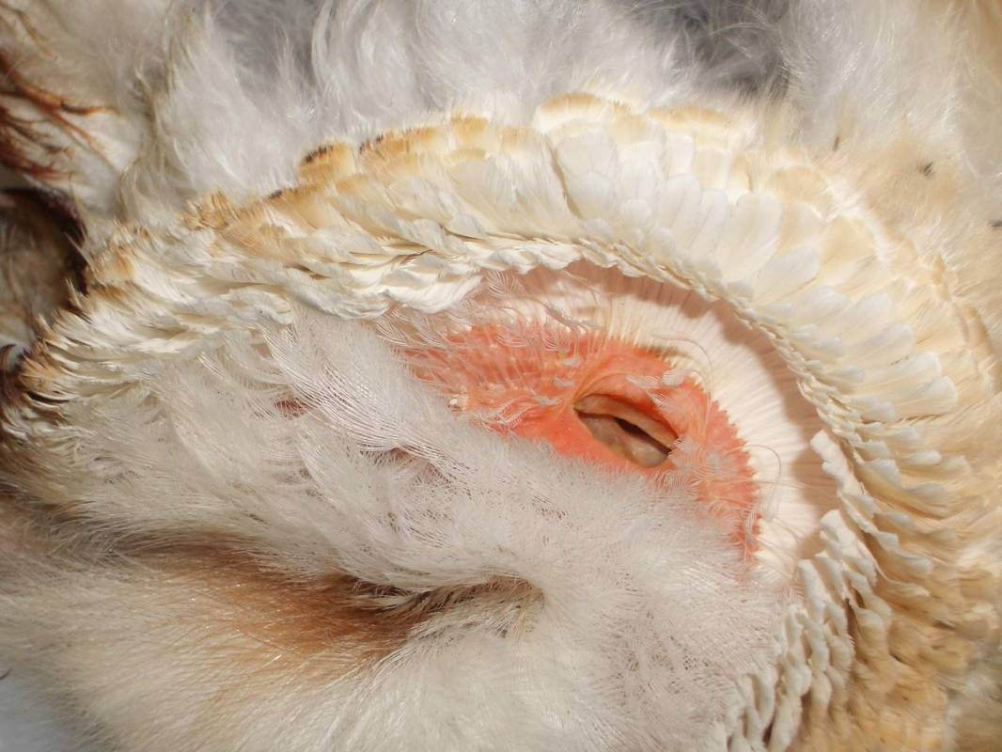

Slide 16
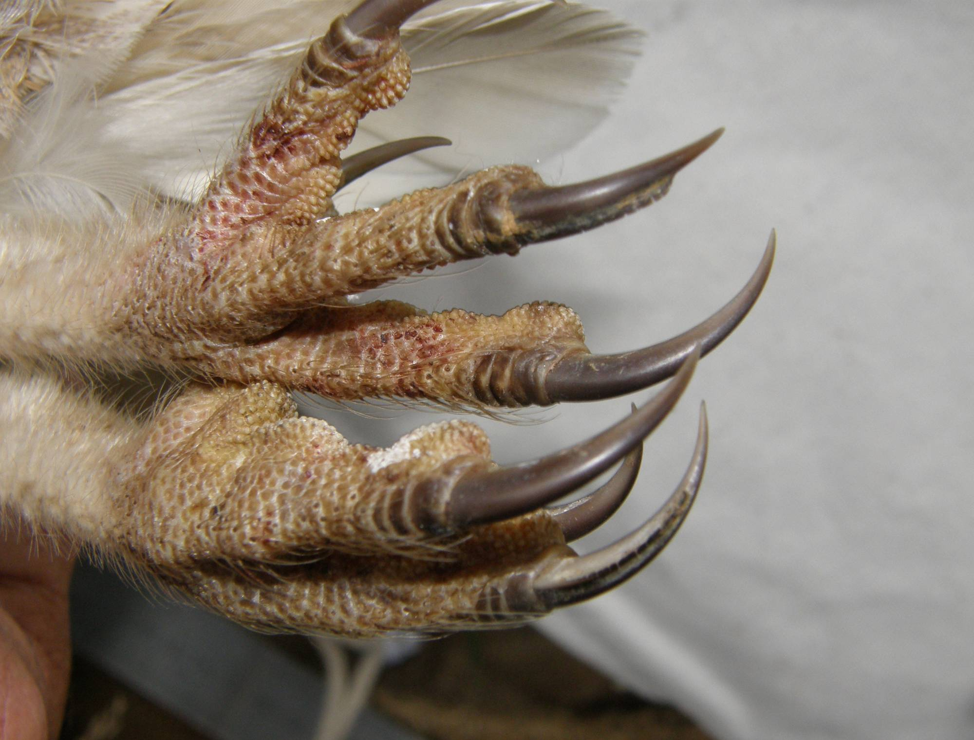

Slide 17
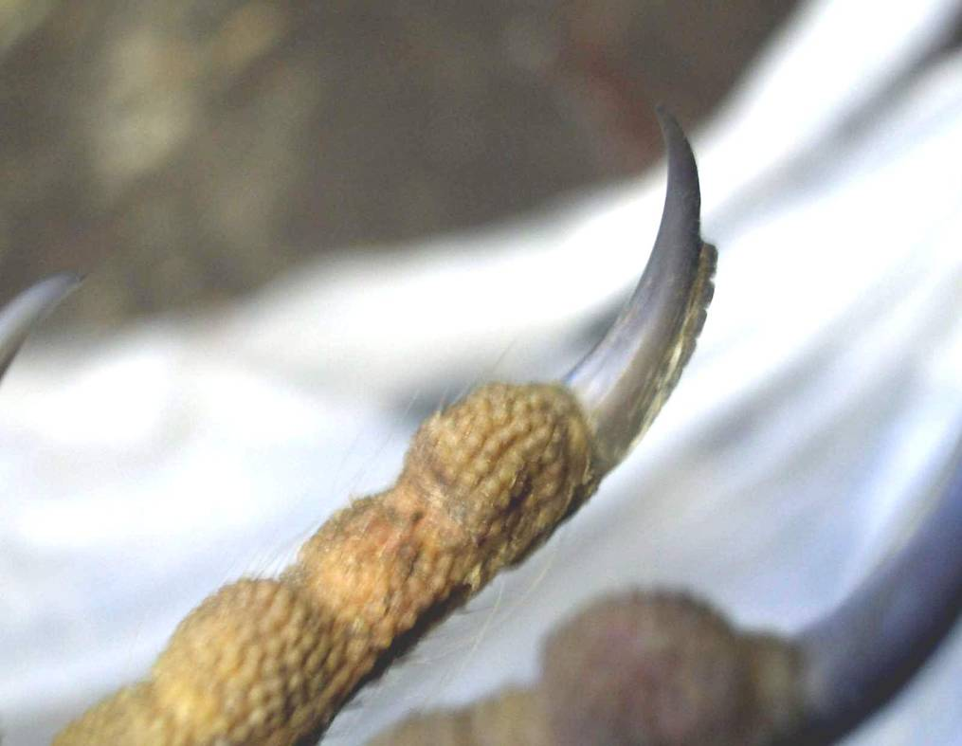
So what else do they use their talons for?

Slide 18
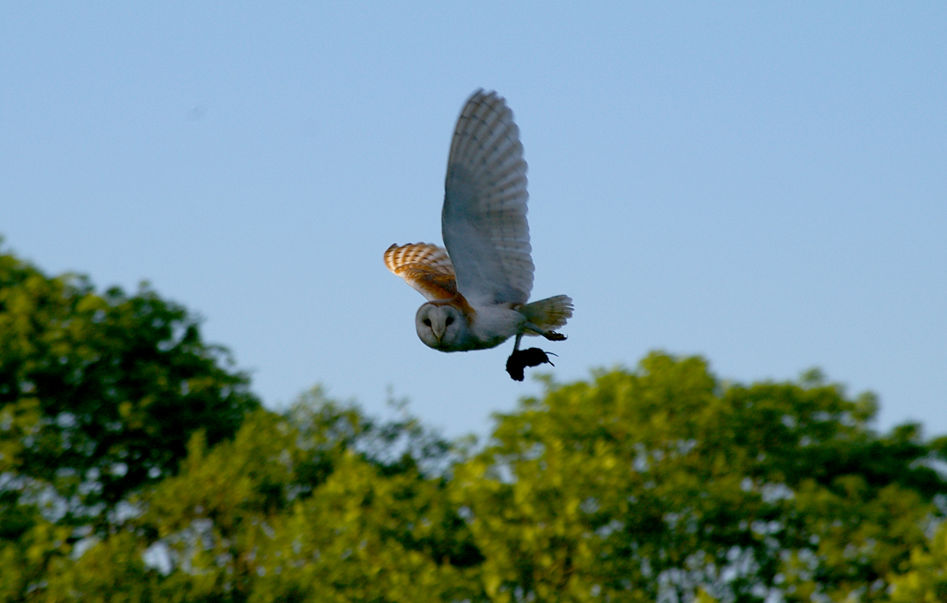

Slide 19
PREY SPECIES %
Field vole
Bank vole
Wood mouse
Common shrew
Pygmy shrew
Water shrew
others
55%
10%
10%
15%
10%

Slide 20
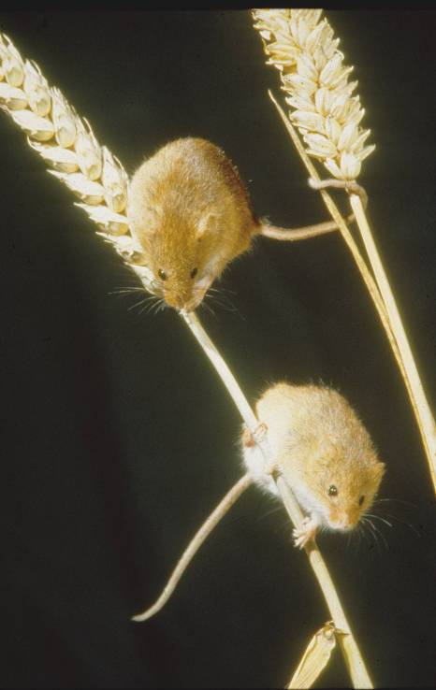
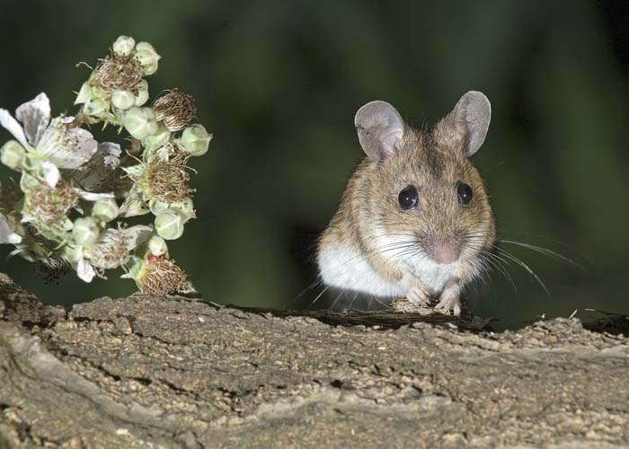
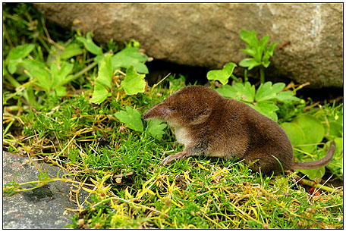
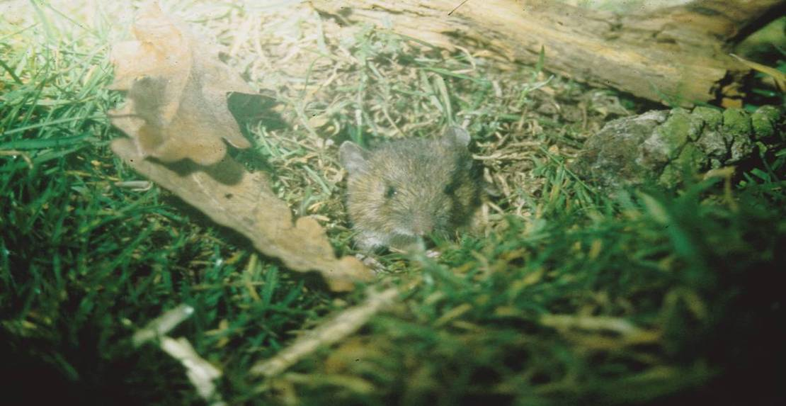
Wood Mouse
Harvest Mouse
Field Vole
Shrew

Slide 21
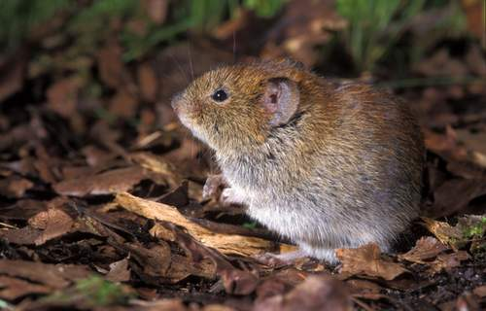
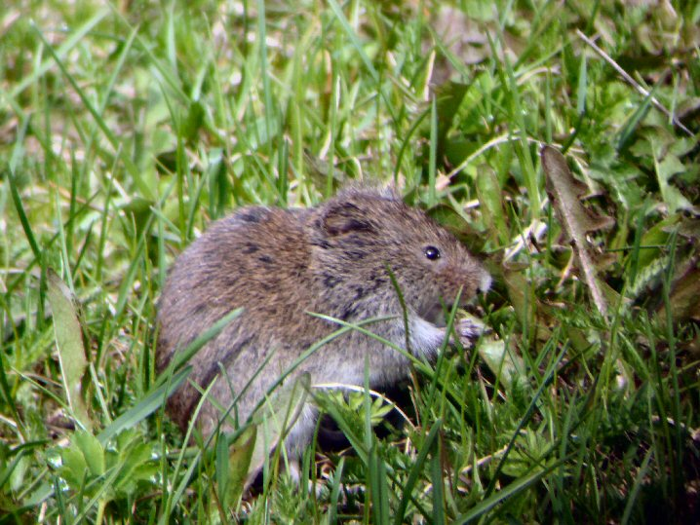
Bank Vole
Field Vole
So what happens to the prey?

Slide 22
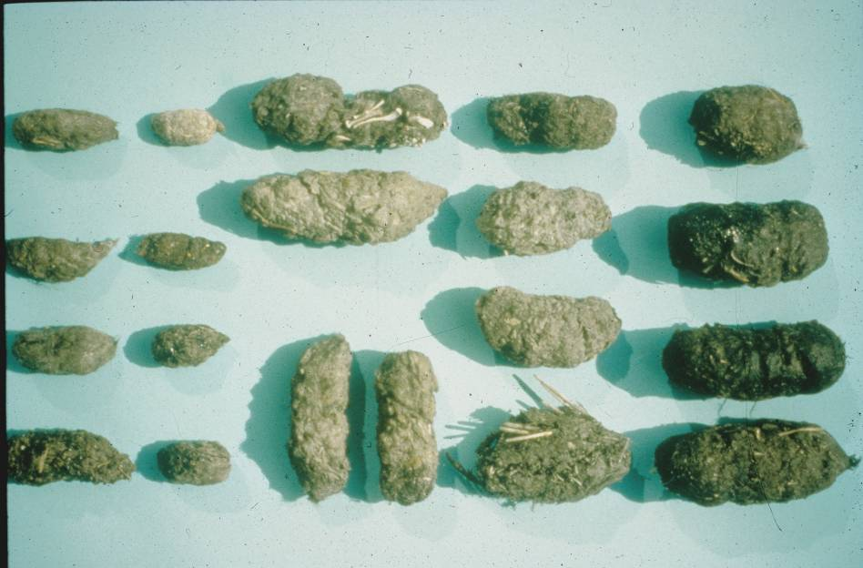
Little Owl
Long Eared Owl
Tawny Owl
Barn Owl
Kestrel
Short Eared Owl

Slide 23
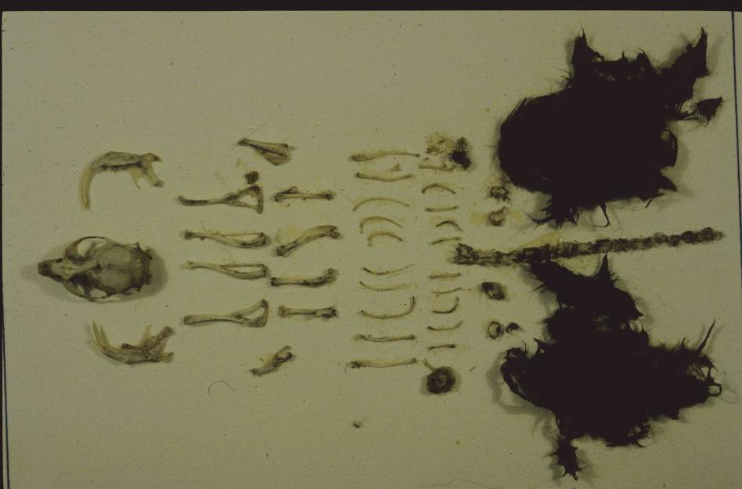

Slide 24
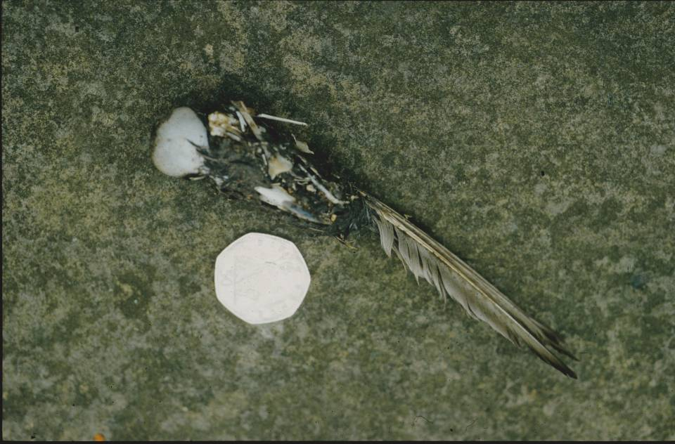

Slide 25
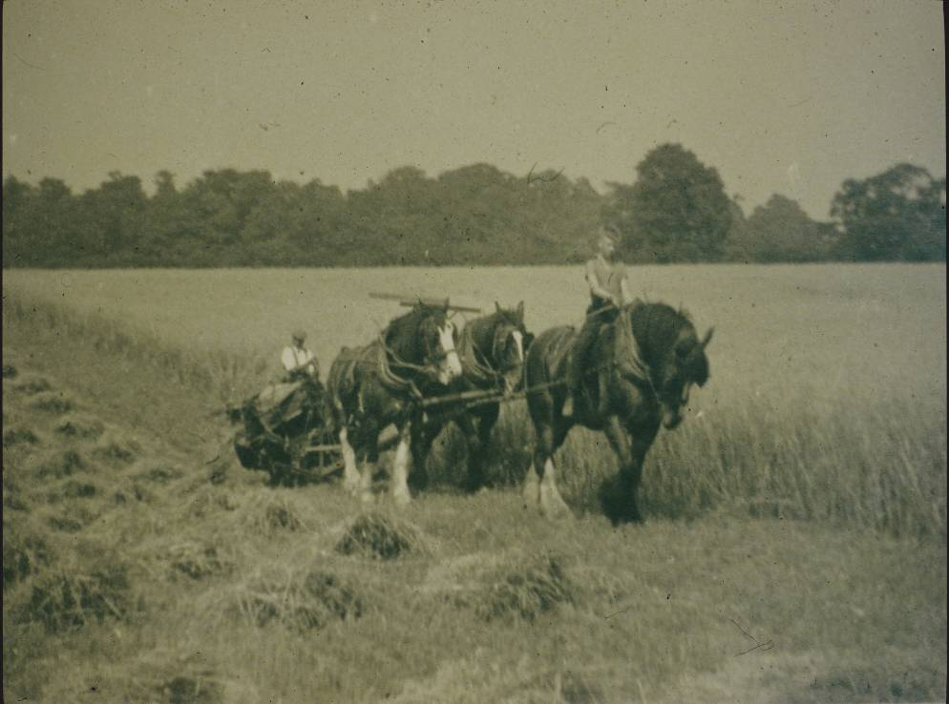
Environment

Slide 26
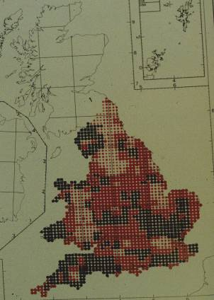
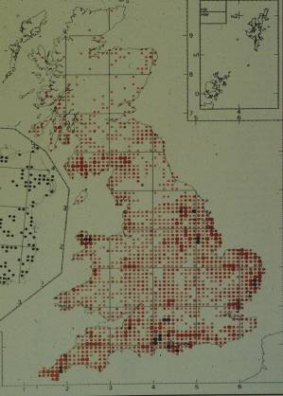
The breeding density and distribution of the Barn Owl in England and Wales
1932
1992

Slide 27
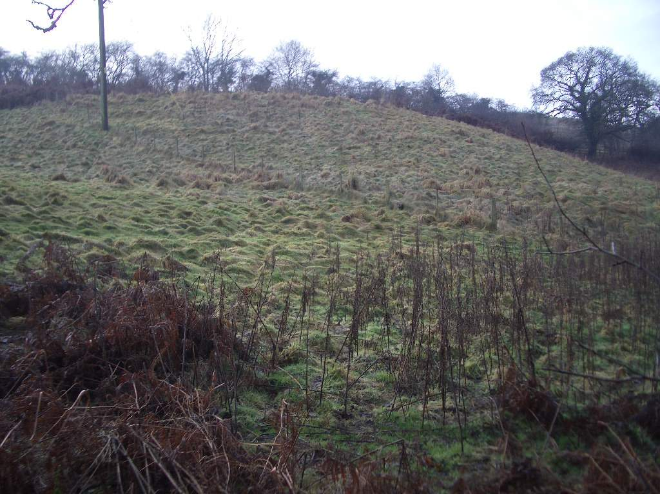

Slide 28
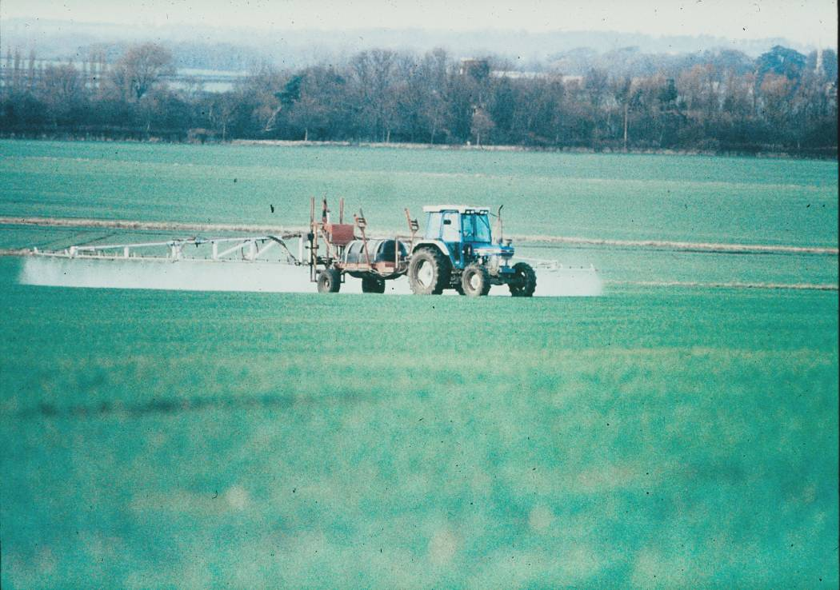

Slide 29
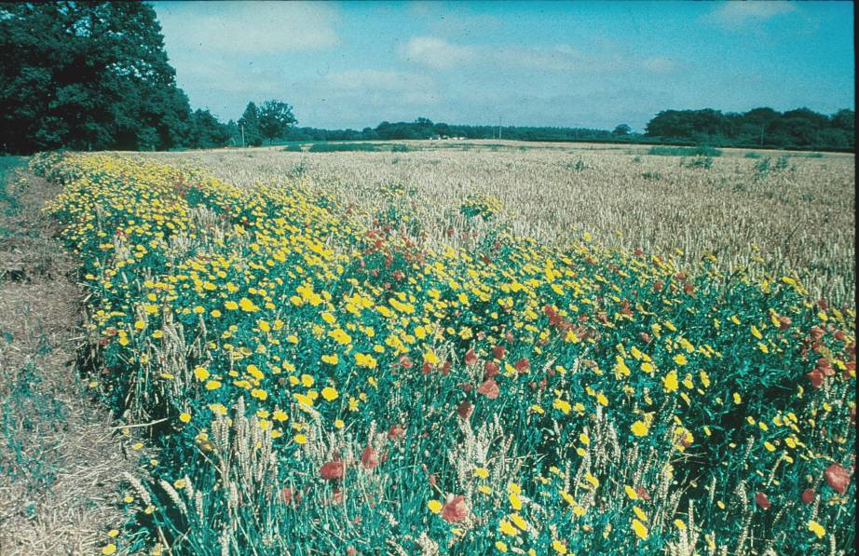
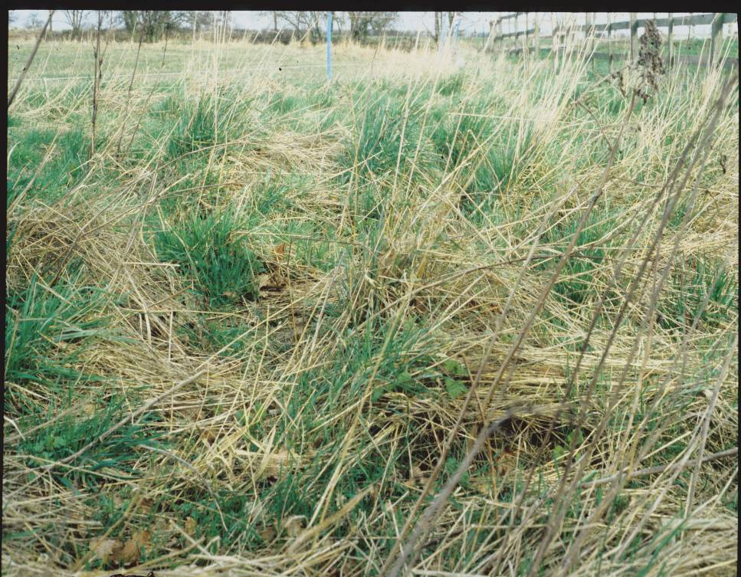

Slide 30
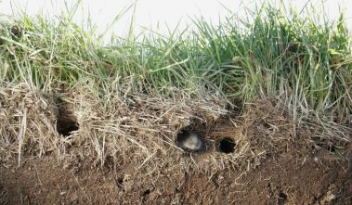

Slide 31
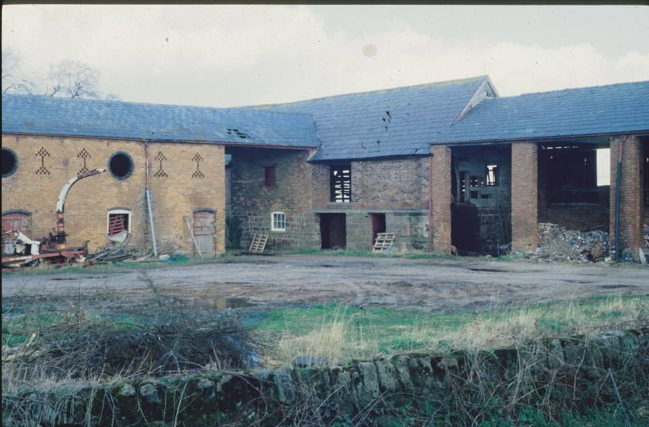

Slide 32
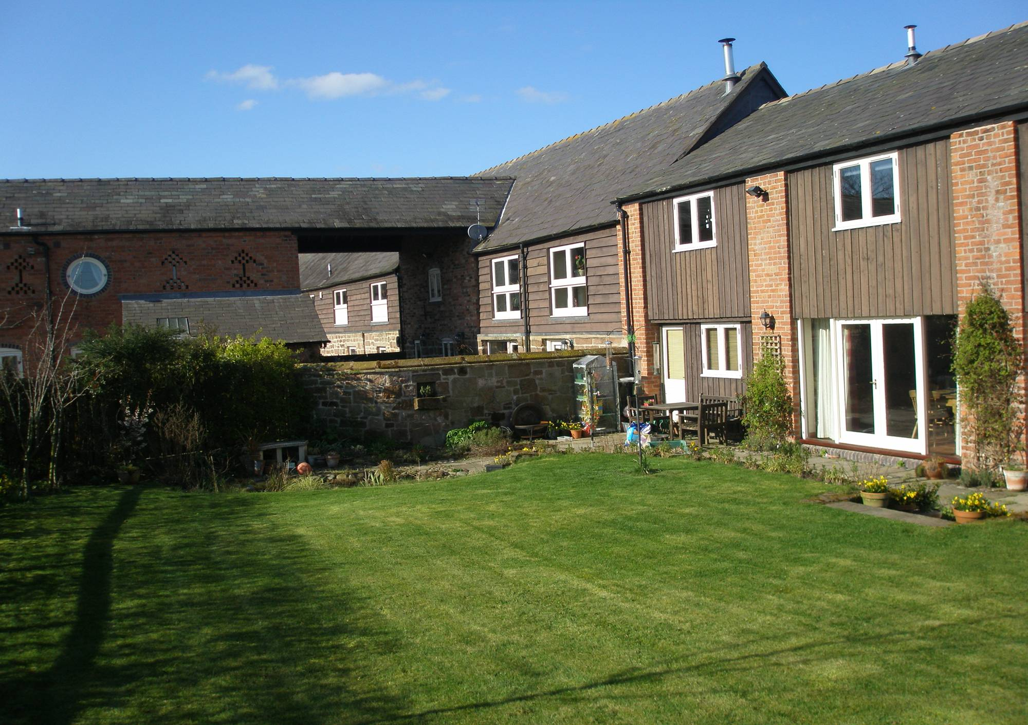
In mid 1990’s the owl population was still in serious decline due to no suitable habitat or breeding places.

Slide 33
The Broxton Barn Owl Group
(BBOG)
1993-4 survey recorded only 6 breeding pairs in Cheshire
  BBOG was formed in 1995 by a group of 6 people
  from the Burwardsley / Broxton area
  Construction & provision of homes for the Owls
  Required the support of farmers and landowners

Slide 34
BBOG Objective
In partnership with the farmers and landowners, to
ensure a long term future for the Barn Owl in
Cheshire
All volunteers give their time and services free of charge
Funding for materials through donations and grants.
What do we get out of this?
A year in the life of BBOG member

Slide 35
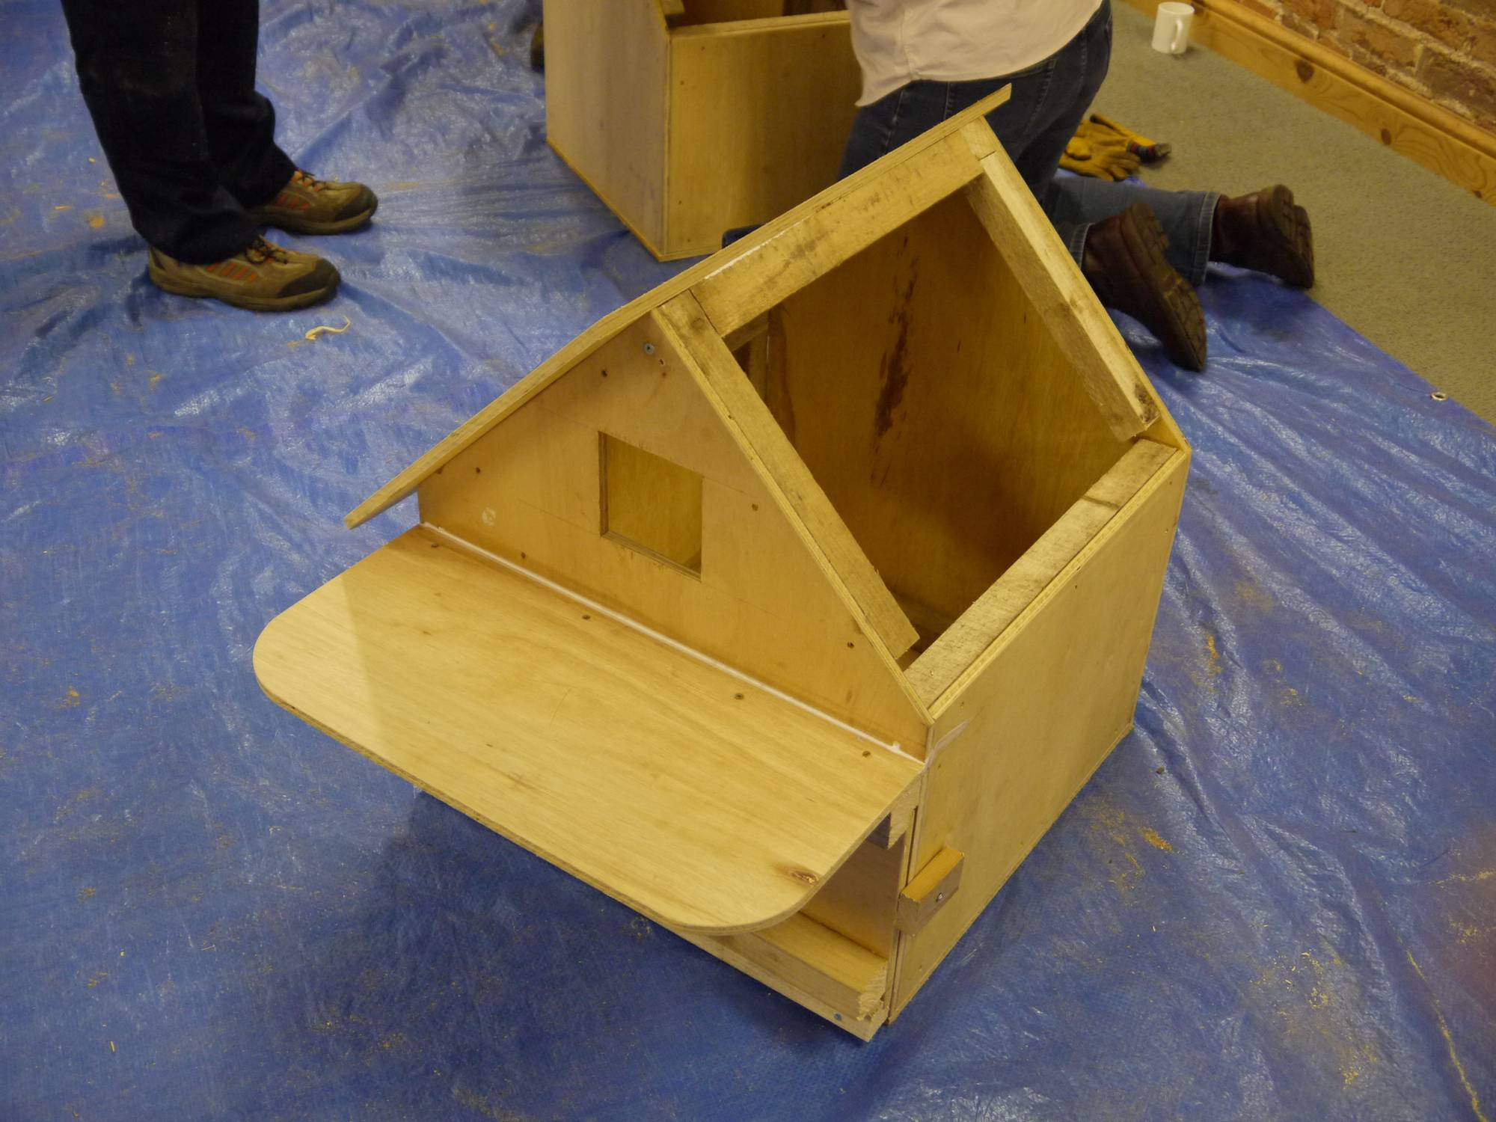

Slide 36
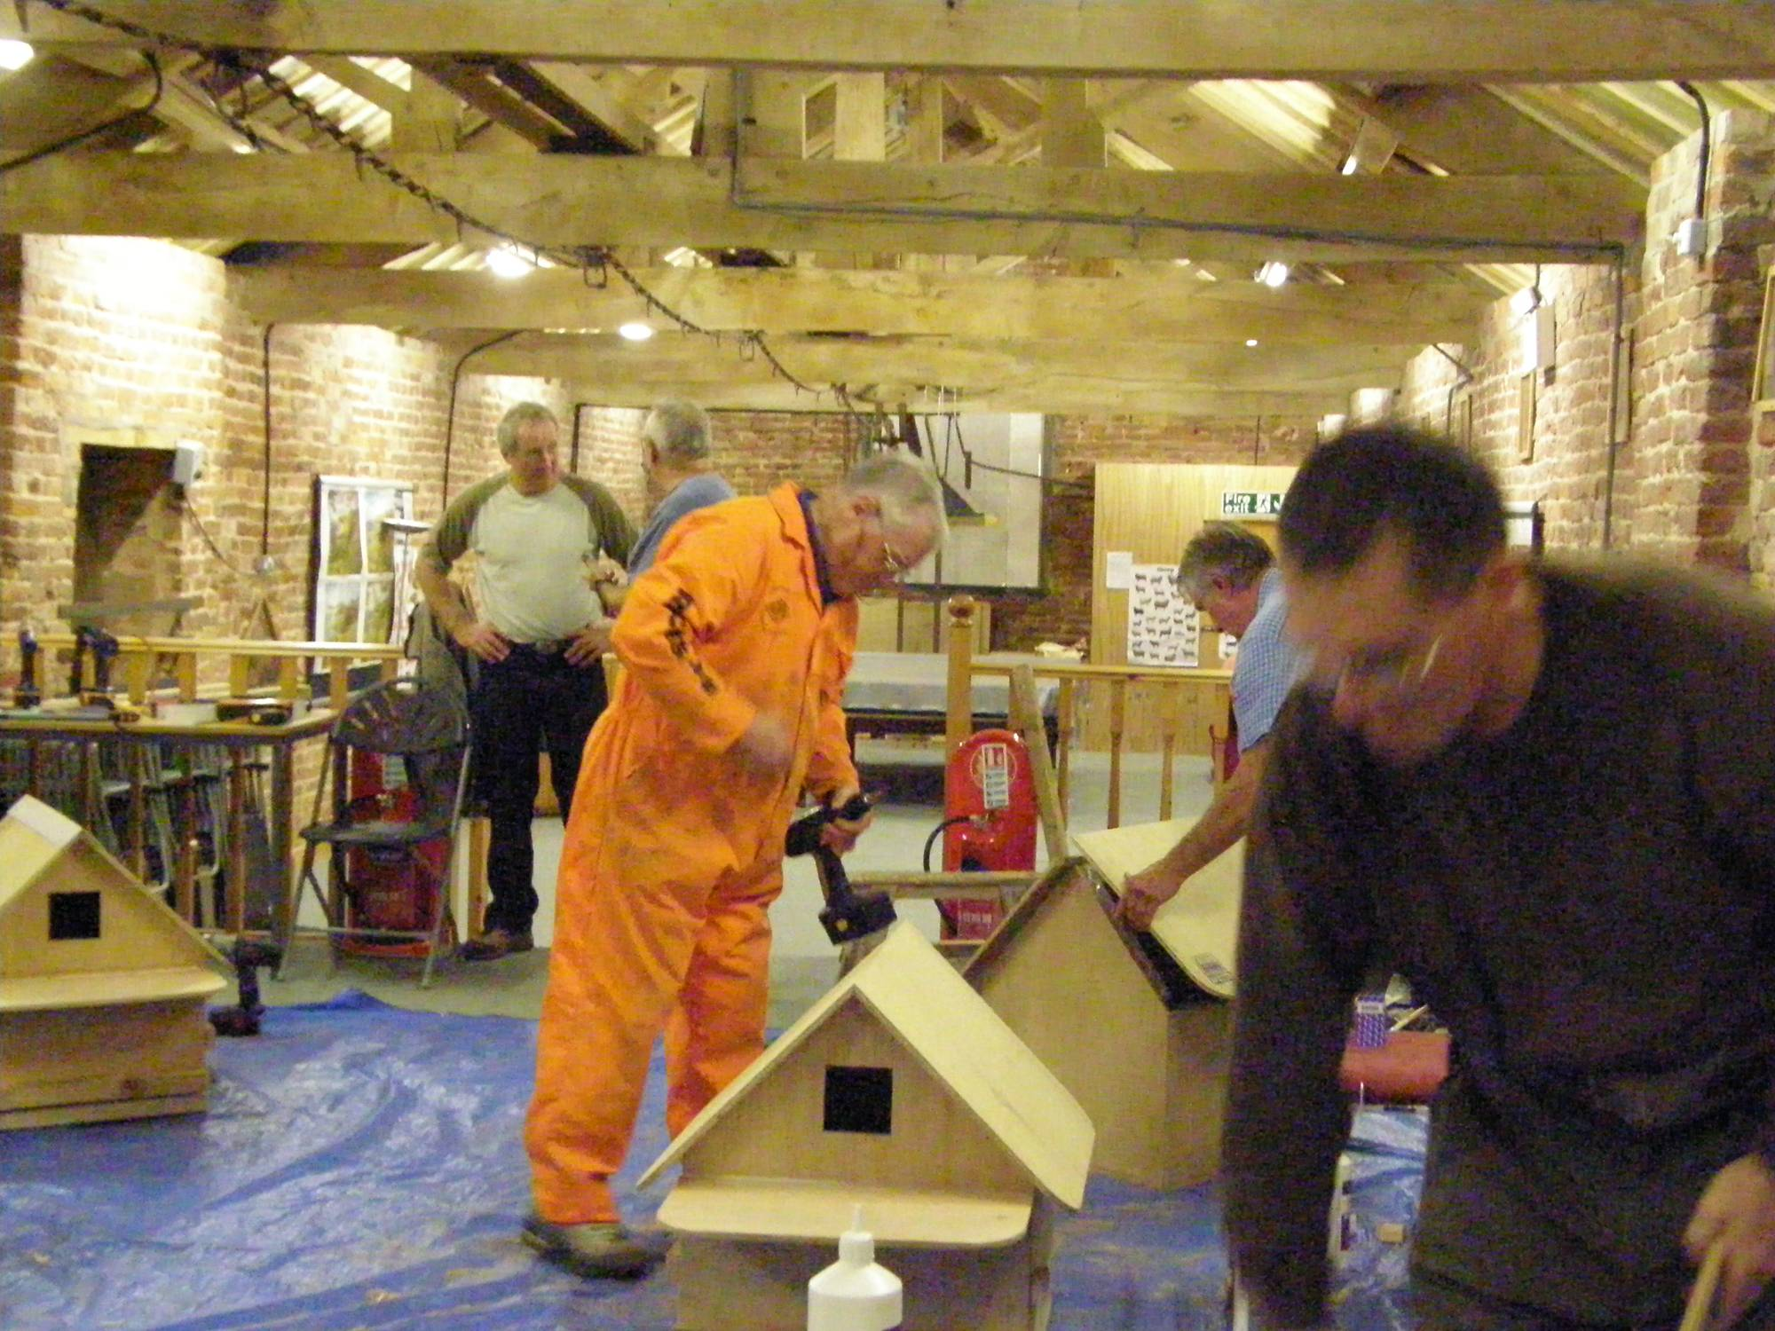

Slide 37
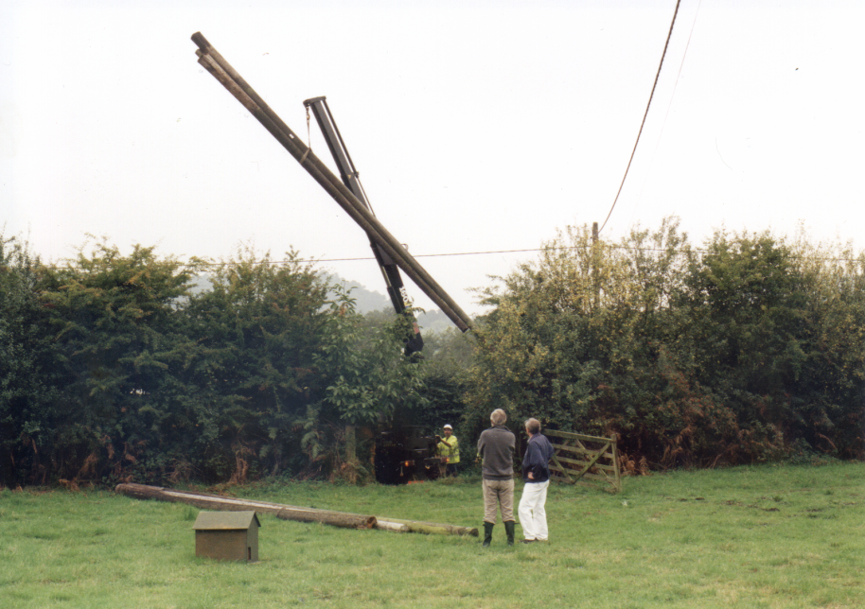
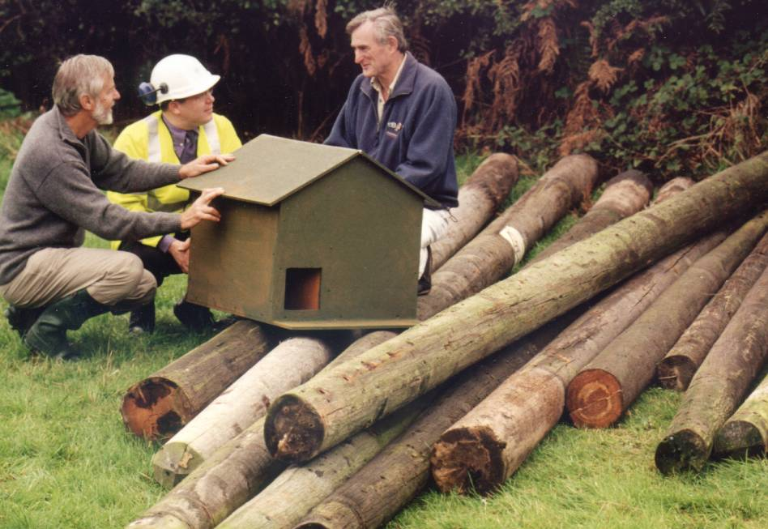

Slide 38
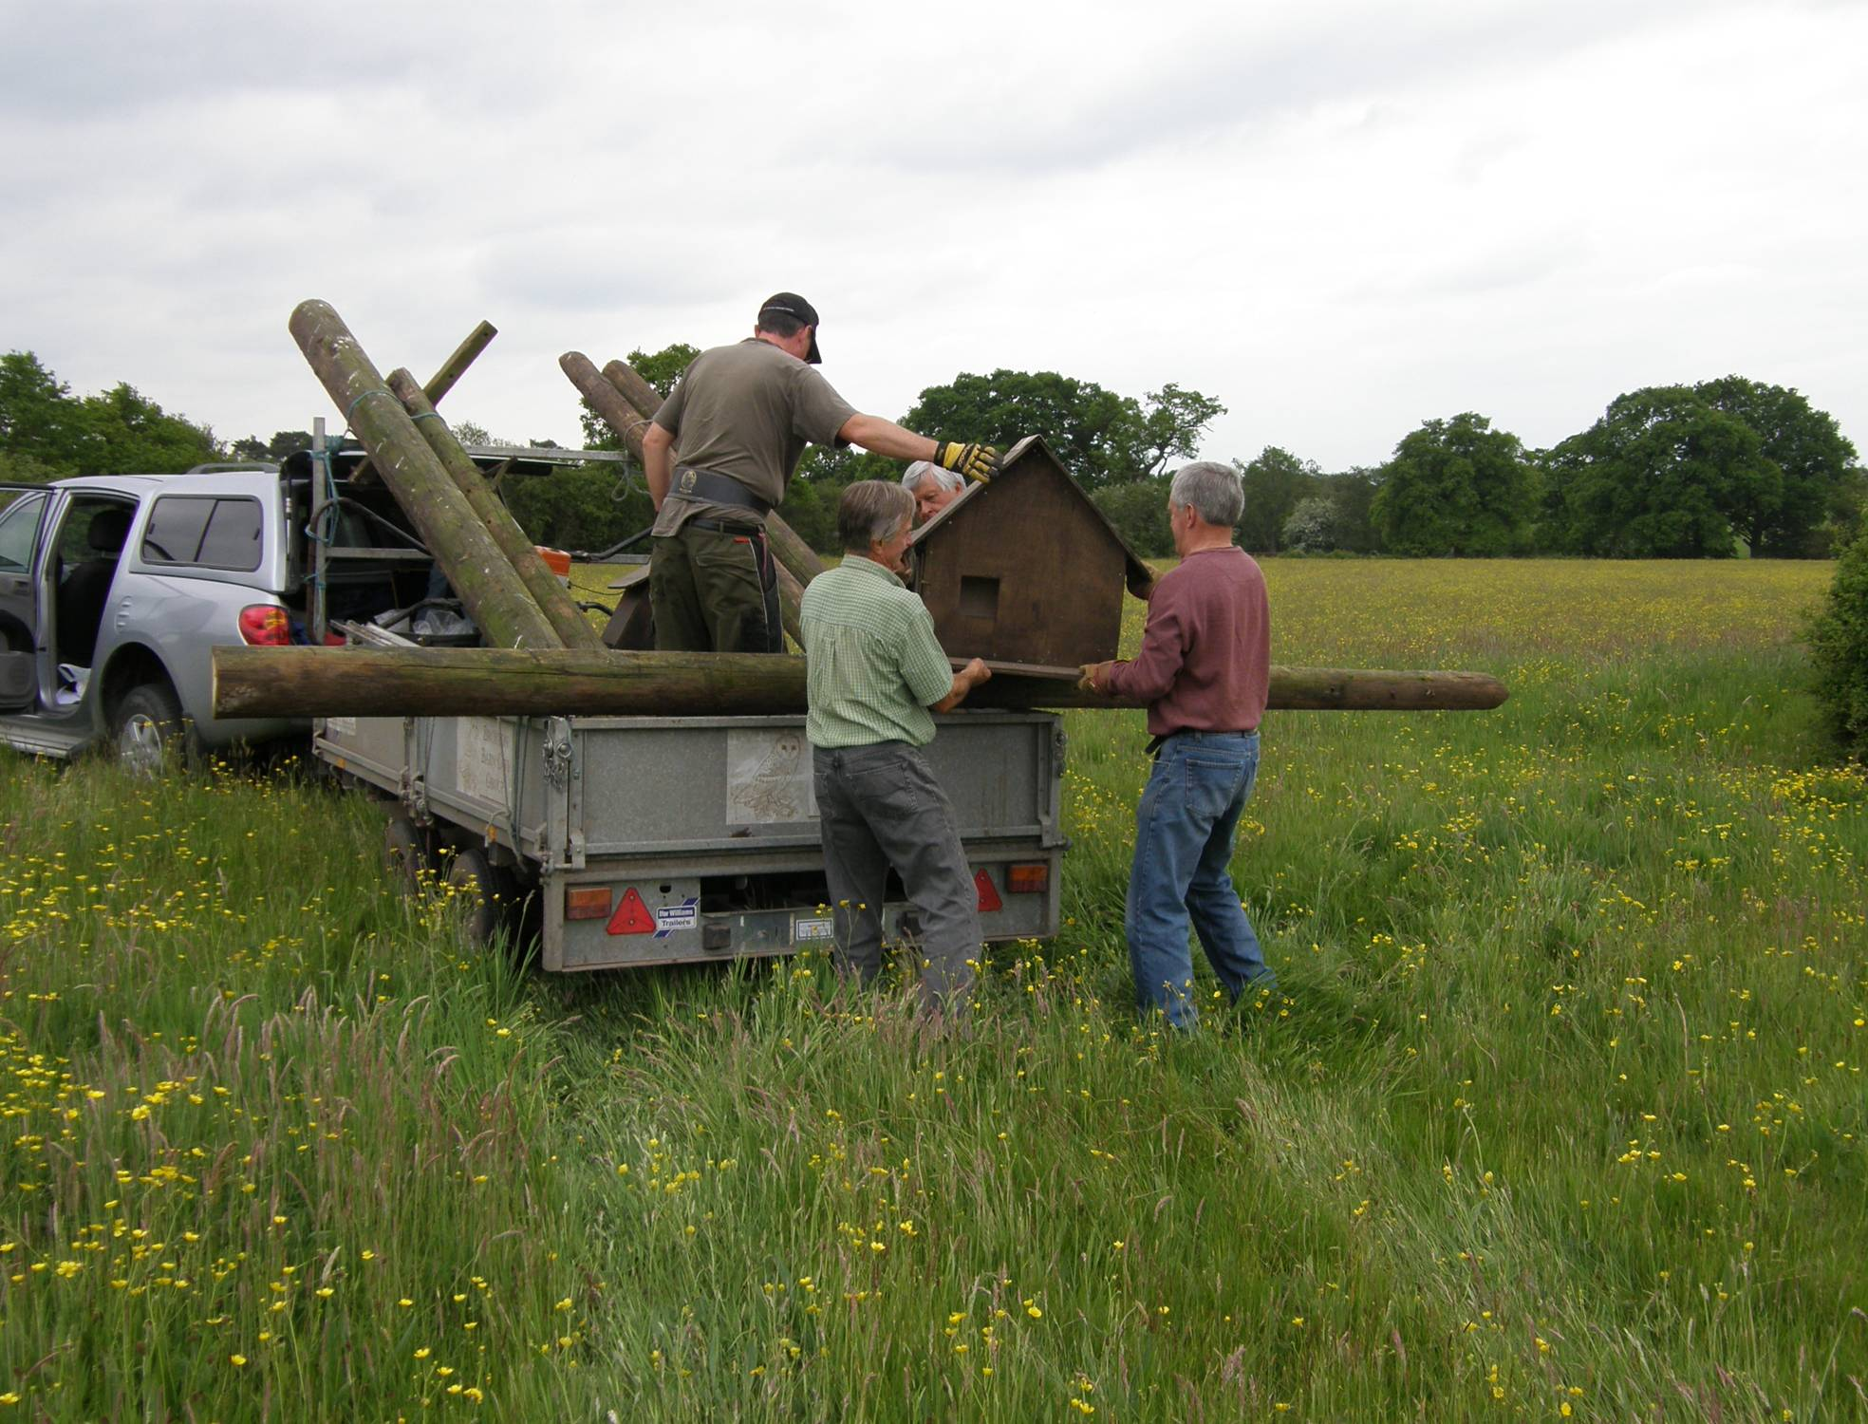
The “B” Team at work

Slide 39
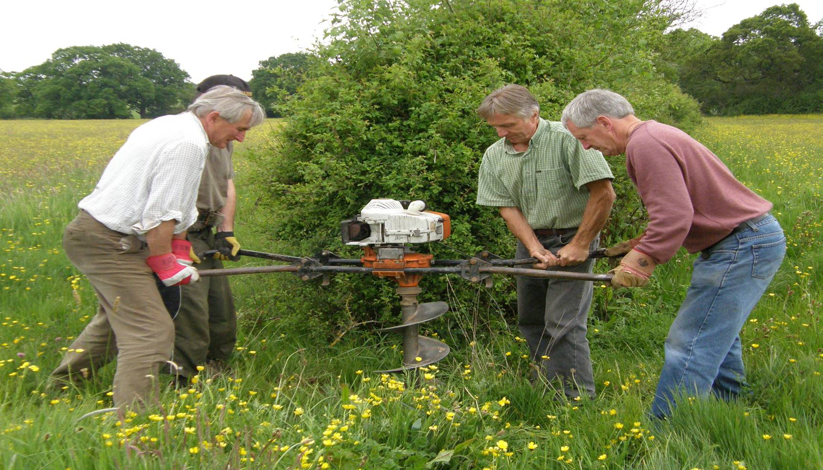
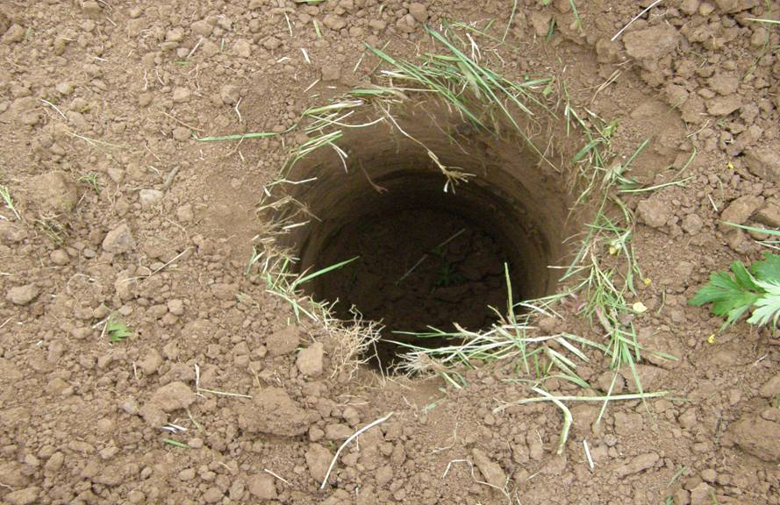

Slide 40
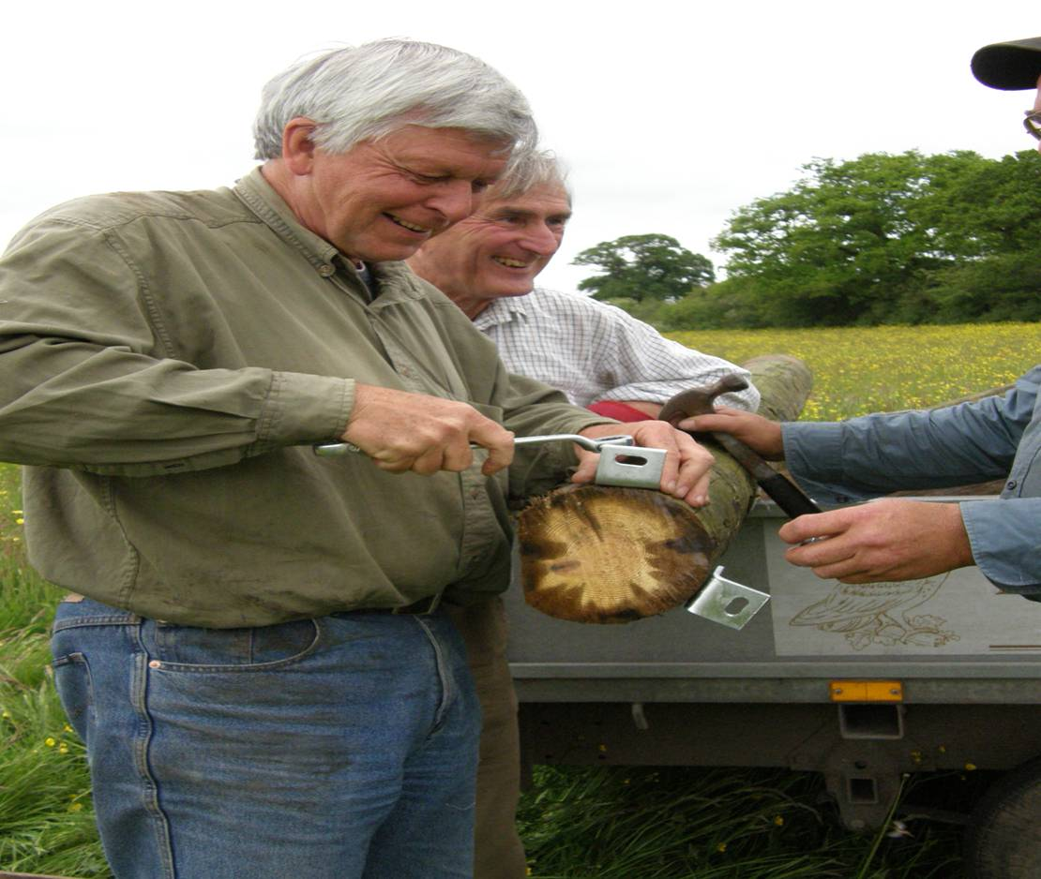
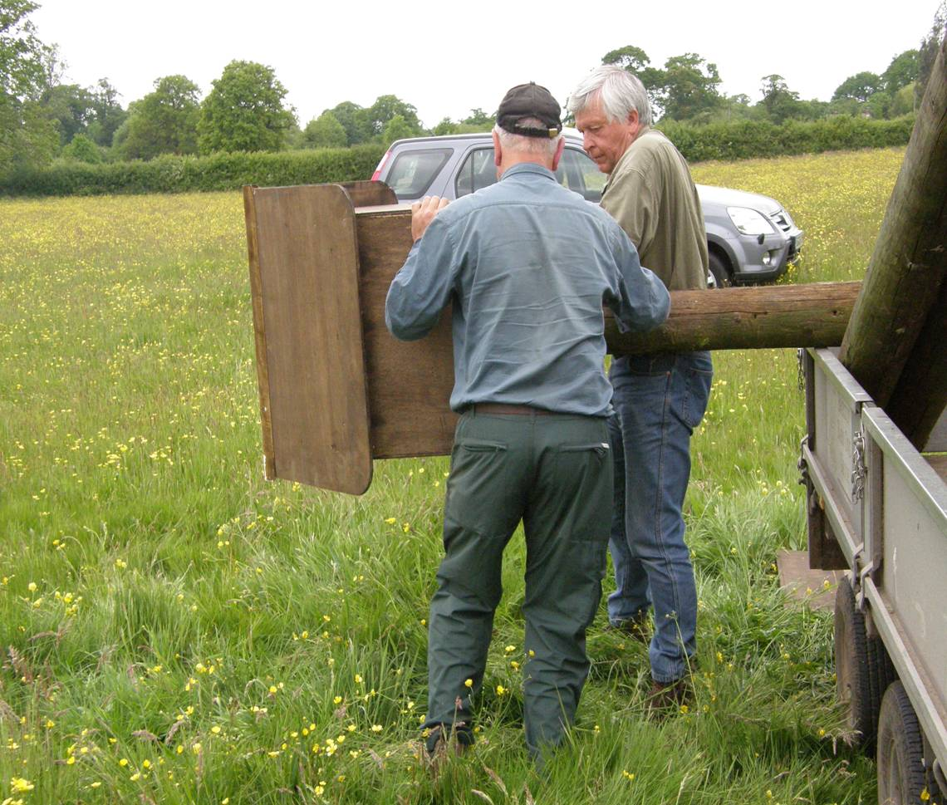

Slide 41
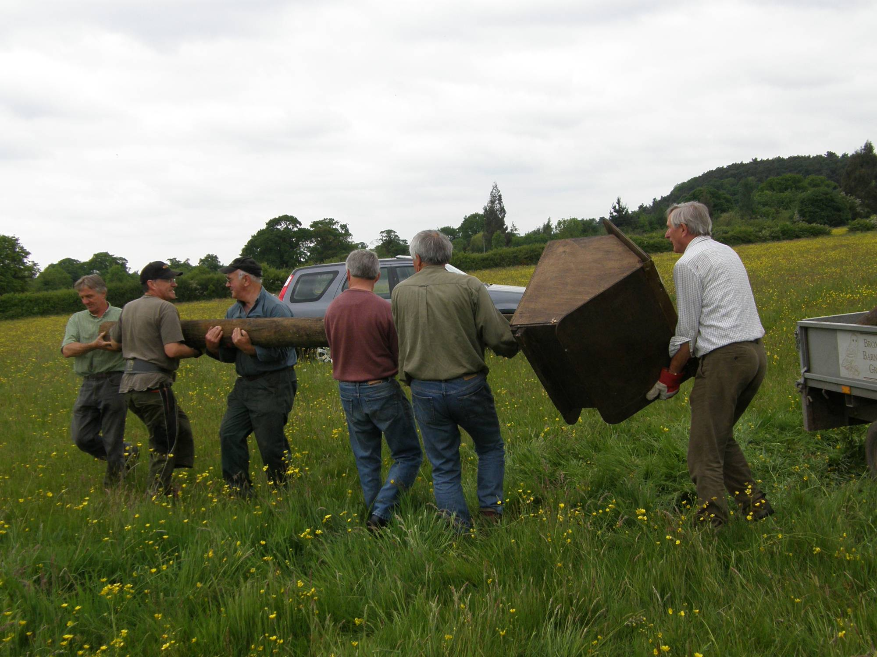

Slide 42


Slide 43


Slide 44


Slide 45


Slide 46


Quality Control

Slide 47


Slide 48


Slide 49


Slide 50


Slide 51


Slide 52


If we are really lucky the owls move in

Slide 53


Slide 54


Slide 55



Trapping the Owls

Slide 56





Slide 57


Slide 58


Slide 59


Slide 60


Slide 61


Slide 62


Slide 63


Slide 64


Slide 65


Slide 66


Be very aware of mother owls

Slide 67


Slide 68


Jackdaws
Squirrels

Slide 69


To ring or not to ring?
Buzzard
Stock Doves
Kestrels
Tawny Owls
Little Owls
Mandarin Ducks

Slide 70


Slide 71


Slide 72


Slide 73


Slide 74


Slide 75


Slide 76

Notes:
76

Slide 77


Slide 78


Slide 79


Slide 80


Slide 81


Slide 82

Why are we doing this work?.
Notes:
82

Slide 83

Why are we doing this work?.
Have we made a diffference?
Notes:
83

Slide 84

Why are we doing this work?.

Slide 85


Have we made a difference?
Cheshire Summary
We believe we are making a difference, but there is still more to do

Slide 86
Pulli Ringed
Autumn 2010 Review
We believe we are making a difference, but there is still more to do
Finally…

Slide 87
Autumn 2015 Review
We believe we are making a difference, but there is still more to do
Finally…

Slide 88
Summary of Breeding Survey
 | 2018 | 2017 | 2016 | 2015 | 2014 | 2013 | 2012 | 2011 | 2010 | 2009 | 2008 | 2007 | 2006 | 2005 | 2004
Barn Owls:
pulli ringed | 105 | 137 | 120 | 62 | 180 | 13 | 198 | 116 | 97 | 127 | 61 | 165 | 14 | 130 | 74
Total nest sites | 44 | 49 | 44 | 32 | 40 | 4 | 66 | 38 | 41 | 43 | 28 | 35 | 5 | 38 | 36
Pulli /nest | 2.4 | 2.8 | 2.7 | 2 | 4.5 | 3.2 | 3 | 3.05 | 2.3 | 3 | 2.2 | 4.7 | 2.8 | 3.4 | 2
*Total no Boxes | 500 | 472 | 467 | 457 | 443 | 430 | 424 | 405 | 397 | 326 | 303 | 270 | 227 | 194 | 178
adults ringed | 13 | 11 | 10 | 18 | 27 | 20 | 15 |  | 23 | 12 | 12 | 12 | 17 | 18 | 13
adults retrapped | 12 | 13 | 13 | 18 |  |  | 24 | 14 | 26 | 22 | 20 | 10 | 6 | 9 | 6
Other Species:
Kestrel pulli ringed | 27 | 35 | 19 | 22 | 20 |  | 31 | 37 | 28 | 48 | 25 | 59 | 17 | 59 | 35
Kestrel adults ringed |  | - | 1 |  |  |  | 2 | 0 | 2 | 6 | 0 | 3 | 1 | 2 | 0
Kestrel breeding sites |  | 10 | 6 | 6 | 6 |  | 10 | 10 | 11 | 11 | 8 | 17 | 7 | 17 | 11
Kestrel pulli/nest |  | 3.5 | 3.2 | 3.7 | 3.3 |  | 3.1 | 3.7 | 3 | 4.4 | 3.1 | 3.5 | 2.4 | 3.5 | 3.2
Stock doves Jackdaws |  |  |  |  |  |  |  |  | Lots more ! | Lots! |  |  |  | 1 | 2
 |  |  | 2
Little Owl pulli |  |  | - | - | - |  |  | 0 | 7 | 5 | 3 |  |  | 3
Tawny Owl | 2 | 3 | 4 | 3 | 8 |  |  | 3 | 3 | 3 | 1 | 1 | 2
Tawny Nests | 1 | 1 | 2 | 1 | 2 |  |  | 1 | 1 | 1
interim 2017 barn owl breeding stats for Cheshire:
 |  | nest sites | pulli
Mid Chesh |  | 102 |  | 220
Wirral |  | 36 |  | 82
BBOG |  | 49 |  | 137
Totals |  | 187 |  | 439

Slide 89
Our own Barn Owls
www.bbog.co.uk

Slide 90


Slide 91

Any questions?

